Slide 1

Deep Learning
From http://neuralnetworksanddeeplearning.com

Slide 2
딥러닝
수 만 개의 입력 데이터 (예: 이미지, 오디오)가 있고 이것들로부터 사람이
1. “이 사진은 사람이다 동물이다” 등의 분류가 가능하거나 2. “이 사진으로부터 특정 모양을 찾아내거나 분리＂가 가능하거나
3. 이런 작업을 프로그램으로 성취 하려고 하는데, 경우의 수가 너무 많아 프로그램하기 어려우면,
딥러닝을 적용할 수 있음.
위에서 수십만 개의 입력 데이터이라고 했는데 여기에 주목해야..
딥러닝은 사실 많은 문제를 해결해 주기는 하지만, 수만의 데이터를 미리 준비하고 손질해서, 문제를 푸는 방법임. 딥러닝을 프로그램으로 짤 것은 얼마 안됨. 또한 엄청난 계산과 메모리를 필요로 하므로 H/W 시장이 커질 것임

Slide 3
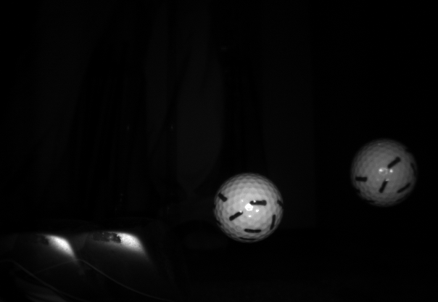
예를 들어
오른쪽 같이 아주 명확한 사진 속에서 골프 공을 찾아내기 위해 5가지 이상의 Heuristics가 사용 되었다.
예를 들어, median filter 적용 후 (noise 제거)
Smoothing 후
Edge detection
Edge thinning
circle detection…
다양한 새로운 조건에 따라서 실패, 실패, 실패..
10년 이상의 경험을 가진 전문가가 full time으로 프로그램을 만드는데 드는 시간이 4-5개월 이상 소요

Slide 4
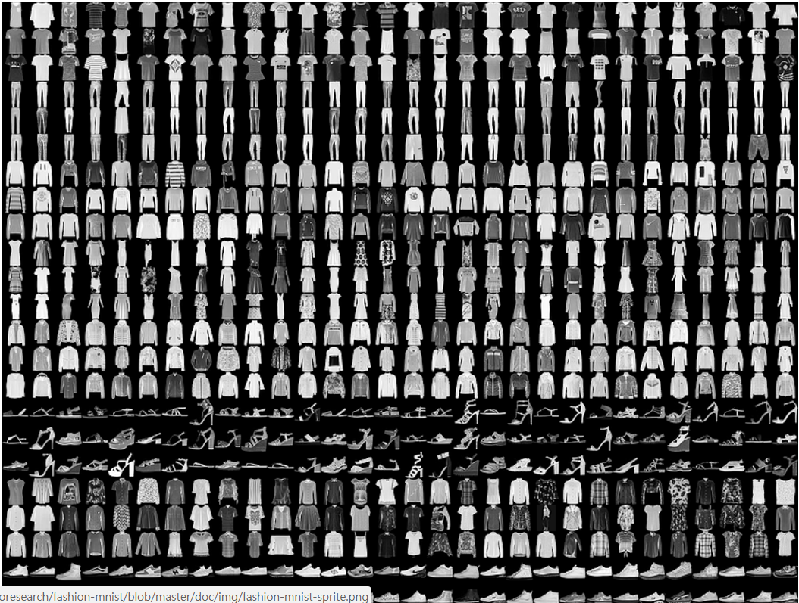
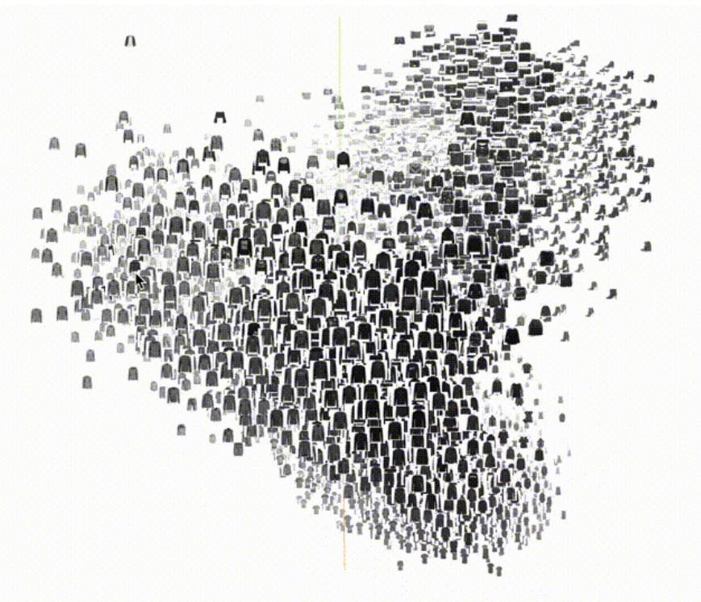
But you need massive amount of data
환상을 깨야 됨.. 100만장, 1000만장…!!!
data만 있으면 답이 있다 !!
From alogorithmic indetermisticity to data-deterministicity
Our experience says that we need several thousands images, and some augmentation techniques, through which we could reach to millions of images.

Slide 5
Let us see the training data set
DEMO
Point: how vast the dataset is
Microsoft COCO DB 2014
MNIST numeric handwriting train data set

Slide 6
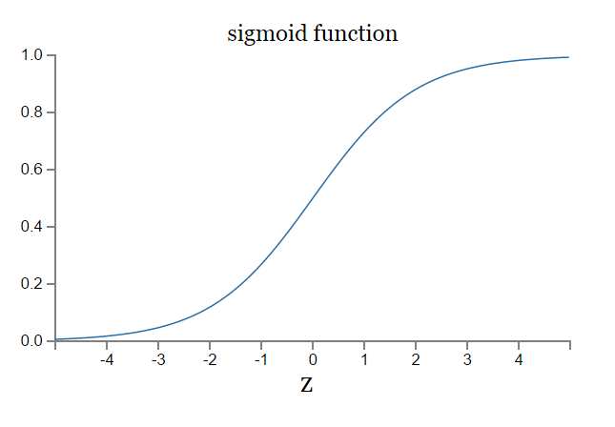
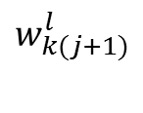
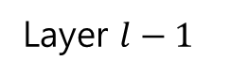
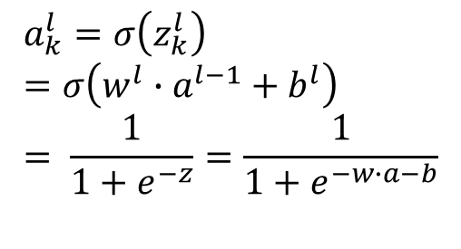
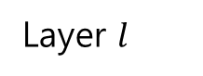
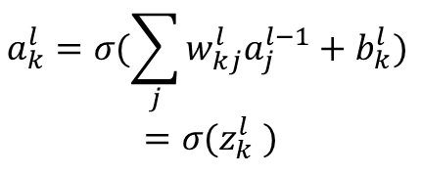
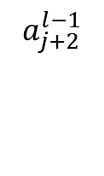
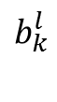
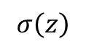
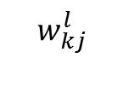
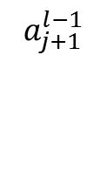
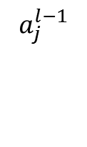
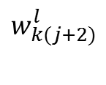
Sigmoid Neuron
Layer $l−1$
Layer $l$
$$a_{k}^{l}=σ(\sum_{j}{w_{kj}^{l}a_{j}^{l−1}+b_{k}^{l})}$$
$$=σ(z_{k}^{l} )$$
$$a_{j}^{l−1}$$
$$w_{kj}^{l}$$
K번째
Differentiable function 만들기 위해
$$b_{k}^{l}$$
$$σ\left(z\right)$$
$$w_{k(j+1)}^{l}$$
$$a_{j+1}^{l−1}$$
K번째
$$a_{k}^{l}=σ\left(z_{k}^{l}\right)=σ\left(w^{l}∙a^{l−1}+b^{l}\right)= \frac{1}{1+e^{−z}}=\frac{1}{1+e^{−w∙a−b}}$$
$$w_{k(j+2)}^{l}$$
$$a_{j+2}^{l−1}$$

Slide 7
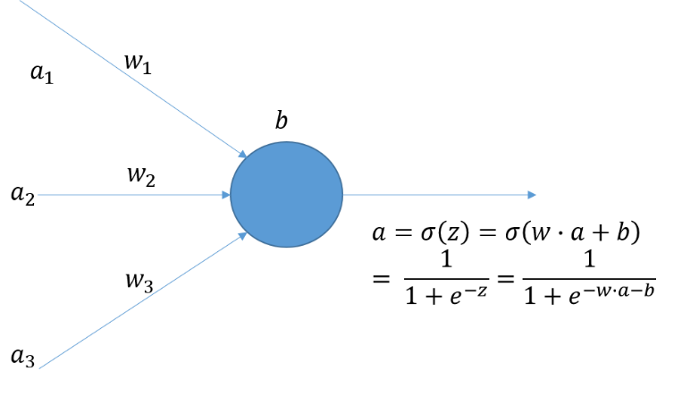
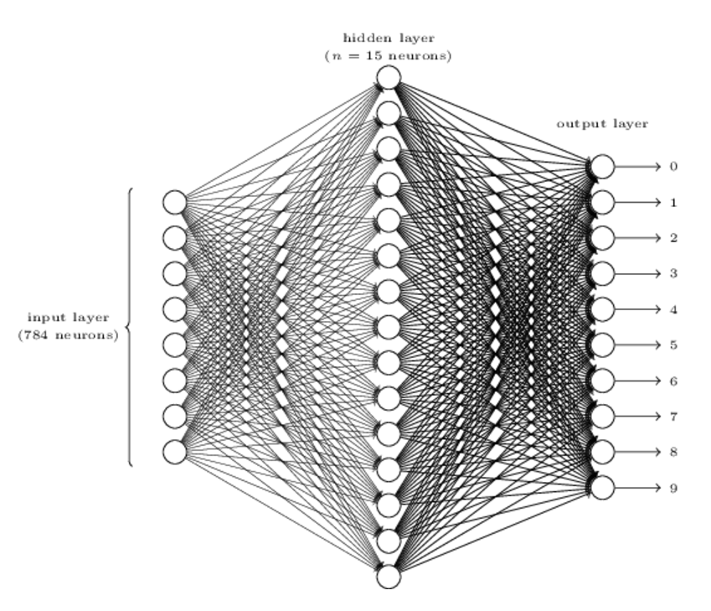
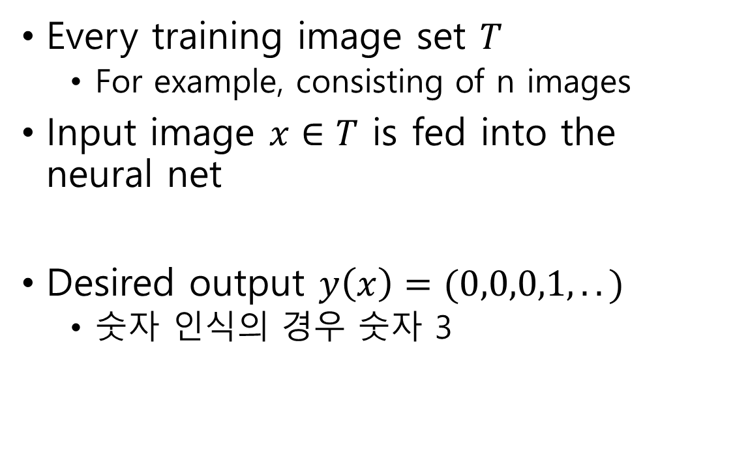
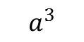
Environment
Every training image set $T$
For example, consisting of n images
Input image $x∈T$ is fed into the neural net
Desired output $y\left(x\right)=(0,0,0,1,..)$
숫자 인식의 경우 숫자 3
각 neuron이 image의 1 pixel
$$a^{3}$$

Slide 8
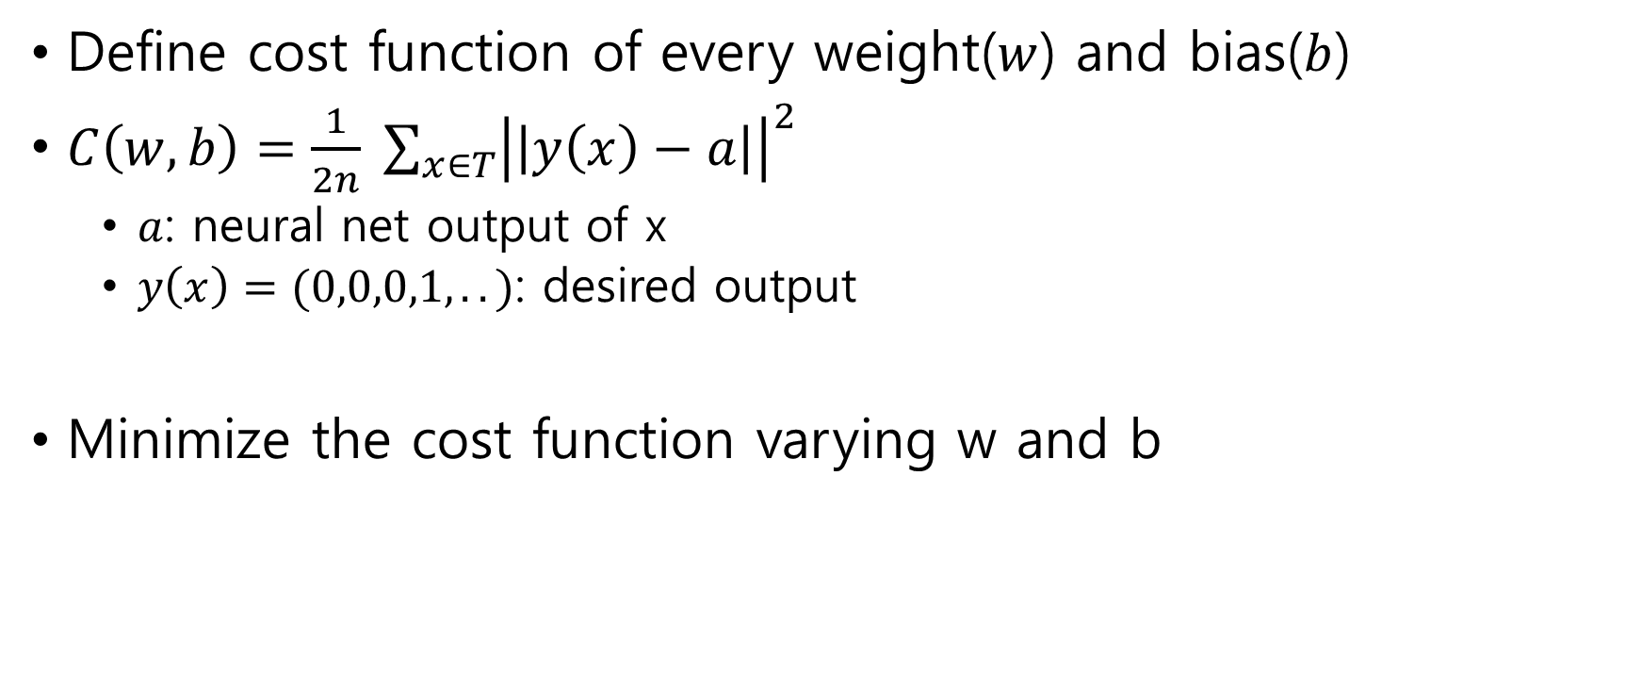
Training the neural network
Define cost function of every weight($w$) and bias($b$)
$C\left(w,b\right)=\frac{1}{2n} {\sum_{x∈T}{\left|\left|y\left(x\right)−a\right|\right|}}^{2}$
$a$: neural net output of x
$y\left(x\right)=(0,0,0,1,..)$: desired output
Minimize the cost function varying w and b

Slide 9
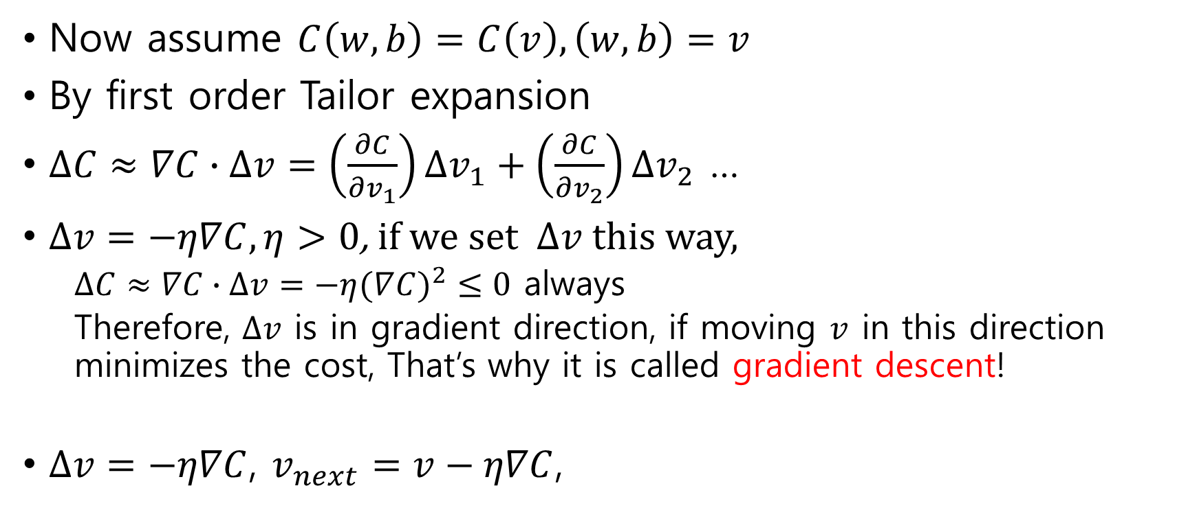
Training the neural network
Now assume $C\left(w,b\right)=C\left(v\right), \left(w,b\right)=v$
By first order Tailor expansion
$∆C≈∇C∙∆v=\left(\frac{∂C}{∂v_{1}}\right)∆v_{1}+\left(\frac{∂C}{∂v_{2}}\right)∆v_{2}$ …
$∆v=−η∇C,η>0$, if we set $∆v$this way,
$∆C≈∇C∙∆v=−η(∇{C)}^{2}≤0$ always
Therefore, $∆v$ is in gradient direction, if moving $v$ in this direction minimizes the cost, That’s why it is called gradient descent!
$∆v=−η∇C$, $v_{next}=v−η∇C$,
Notes:
Eta: learning rate

Slide 10
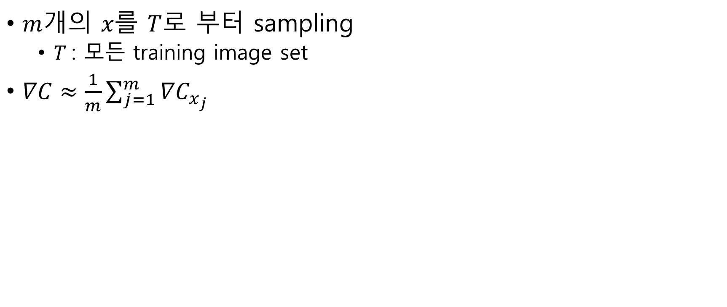
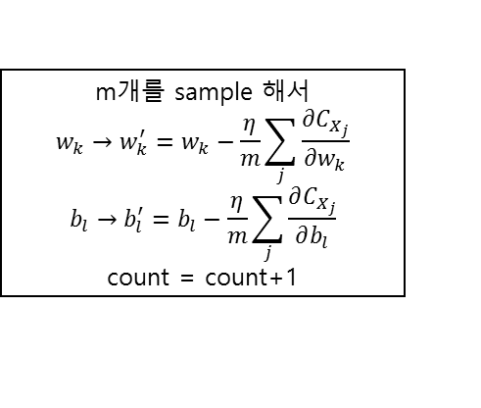

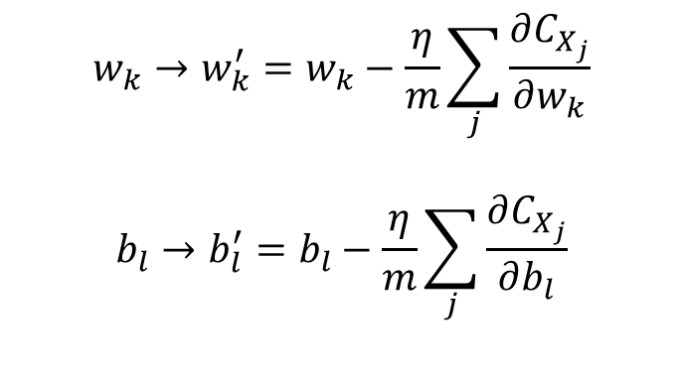
Stochastic Gradient Descent
$w, b$ 초기화
Count = 0
$m$개의 $x를$ $T$로 부터 sampling
$T$: 모든 training image set
$∇C≈\frac{1}{m}\sum_{j=1}^{m}{{∇C}_{x_{j}}}$
Count < n/m
m개를 sample 해서
$$w_{k}→w_{k}^{′}=w_{k}−\frac{η}{m}\sum_{j}{\frac{∂C_{X_{j}}}{∂w_{k}}}$$
$$b_{l}→b_{l}^{′}=b_{l}−\frac{η}{m}\sum_{j}{\frac{∂C_{X_{j}}}{∂b_{l}}}$$
count = count+1
m
m
$$w_{k}→w_{k}^{′}=w_{k}−\frac{η}{m}\sum_{j}{\frac{∂C_{X_{j}}}{∂w_{k}}}$$
$$b_{l}→b_{l}^{′}=b_{l}−\frac{η}{m}\sum_{j}{\frac{∂C_{X_{j}}}{∂b_{l}}}$$
m
m
Epoch = Epoch + 1
Epoch enough

Slide 11
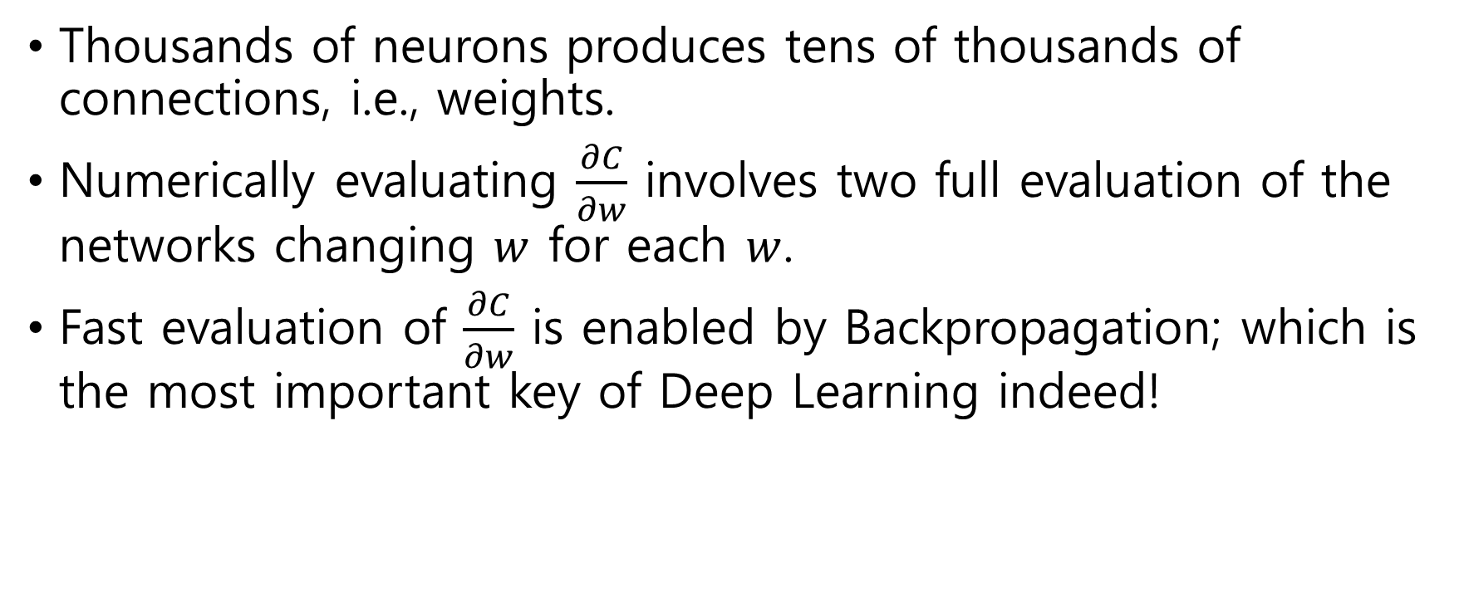
Differentiation w.r.t. every weight and bias
Thousands of neurons produces tens of thousands of connections, i.e., weights.
Numerically evaluating $\frac{∂C}{∂w}$ involves two full evaluation of the networks changing $w$ for each $w$.
Fast evaluation of $\frac{∂C}{∂w}$ is enabled by Backpropagation; which is the most important key of Deep Learning indeed!

Slide 12
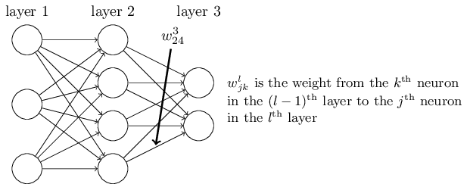
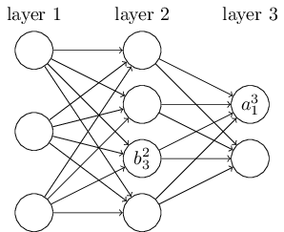
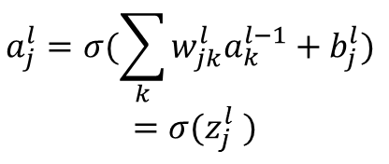
Backpropagation
Notations!
$$a_{j}^{l}=σ(\sum_{k}{w_{jk}^{l}a_{k}^{l−1}+b_{j}^{l})}$$
$$=σ(z_{j}^{l} )$$

Slide 13
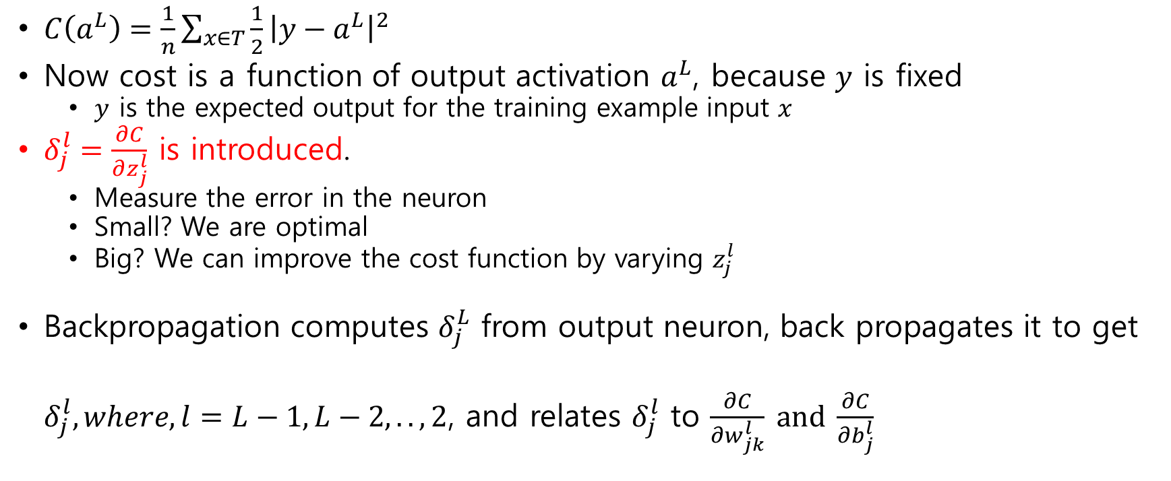
Backpropagation (BP)
$C\left(a^{L}\right)=\frac{1}{n}\sum_{x∈T}{\frac{1}{2}}{\left|y−a^{L}\right|}^{2}$
Now cost is a function of output activation $a^{L}$, because $y$ is fixed
$y$ is the expected output for the training example input $x$
$δ_{j}^{l}=\frac{∂C}{∂z_{j}^{l}}$ is introduced.
Measure the error in the neuron
Small? We are optimal
Big? We can improve the cost function by varying $z_{j}^{l}$
Backpropagation computes $δ_{j}^{L}$ from output neuron, back propagates it to get $δ_{j}^{l}, where, l=L−1, L−2,.., 2$, and relates $δ_{j}^{l}$ to $\frac{∂C}{∂w_{jk}^{l}} and$ $\frac{∂C}{∂b_{j}^{l}}$

Slide 14
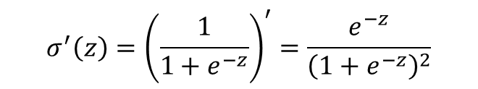
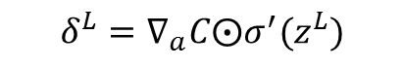
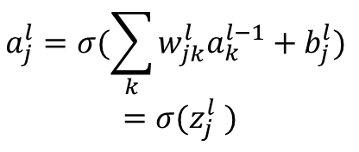
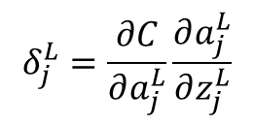
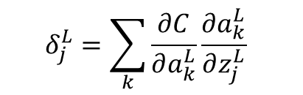
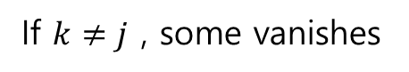

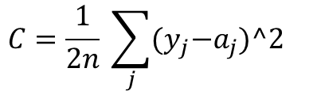
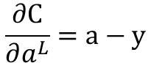
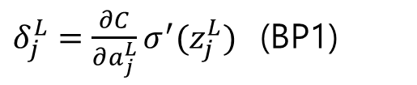
BP 1
Chain Rule: $f\left(x\right)=h\left(g\left(x\right)\right), \frac{∂f}{∂x}=\frac{∂f}{∂g}\frac{∂g}{∂x}$ so, $f^{′}\left(x\right)=h^{′}\left(g\left(x\right)\right)∙g^{′}(x)$
Derivation:
$$a_{j}^{l}=σ(\sum_{k}{w_{jk}^{l}a_{k}^{l−1}+b_{j}^{l})}$$
$$=σ(z_{j}^{l} )$$
$$δ_{j}^{L}=\frac{∂C}{∂z_{j}^{L}}$$
$$δ_{j}^{L}=\sum_{k}{\frac{∂C}{∂a_{k}^{L}}}\frac{∂a_{k}^{L}}{∂z_{j}^{L}}$$
$$σ^{′}\left(z\right)={\left(\frac{1}{1+e^{−z}}\right)}^{′}=\frac{e^{−z}}{{\left(1+e^{−z}\right)}^{2}}$$
If $k≠j$ , some vanishes
$$δ_{j}^{L}=\frac{∂C}{∂a_{j}^{L}}\frac{∂a_{j}^{L}}{∂z_{j}^{L}}$$
$$C=\frac{1}{2n} \sum_{j}{{(y}_{j}−a_{j})^2 }$$
$δ_{j}^{L}=\frac{∂C}{∂a_{j}^{L}}σ^{′}(z_{j}^{L})$ (BP1)
Again by chain rule
$$δ^{L}=∇_{a}C⨀σ^{′}(z^{L})$$
$$\frac{∂C}{∂a^{L}}=a−y$$

Slide 15
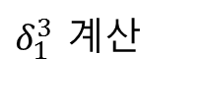
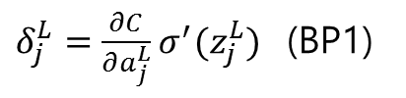
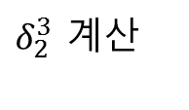
x
$δ_{1}^{3}$ 계산
$δ_{j}^{L}=\frac{∂C}{∂a_{j}^{L}}σ^{′}(z_{j}^{L})$ (BP1)
$δ_{2}^{3}$ 계산

Slide 16
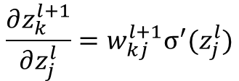
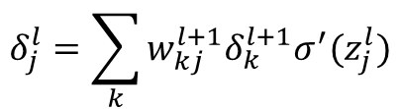
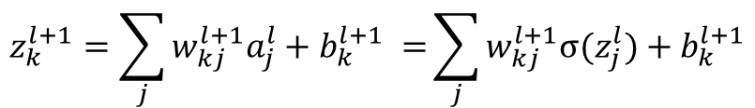
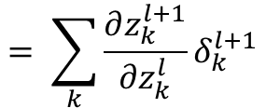
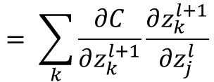
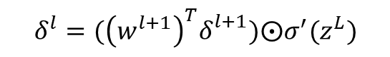
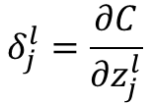
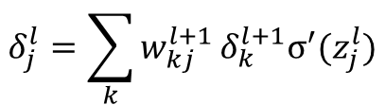
BP 2
$$δ_{j}^{l}=\sum_{k}{w_{kj}^{l+1}δ_{k}^{l+1}σ^{′}(z_{j}^{l})}$$
Derivation:
$$δ_{j}^{l}=\frac{∂C}{∂z_{j}^{l}}$$
$$= \sum_{k}{\frac{∂C}{∂z_{k}^{l+1}}\frac{∂z_{k}^{l+1}}{∂z_{j}^{l}}}$$
$$= \sum_{k}{\frac{∂z_{k}^{l+1}}{∂z_{k}^{l}}δ_{k}^{l+1}}$$
$$z_{k}^{l+1}=\sum_{j}{w_{kj}^{l+1}a_{j}^{l}+b_{k}^{l+1} =}\sum_{j}{w_{kj}^{l+1}σ(z_{j}^{l})+b_{k}^{l+1}}$$
$$\frac{∂z_{k}^{l+1}}{∂z_{j}^{l}}=w_{kj}^{l+1}σ^{′}(z_{j}^{l})$$
$$δ_{j}^{l}=\sum_{k}{w_{kj}^{l+1}}δ_{k}^{l+1}σ^{′}(z_{j}^{l})$$
$$δ^{l}=({\left(w^{l+1}\right)}^{T}δ_{}^{l+1})⨀σ^{′}(z^{L})$$

Slide 17





x
$δ_{1}^{3}$ computed
$δ_{2}^{3}$ computed
$$δ_{4}^{2}=w_{14}^{3}δ_{1}^{3}σ^{′}(z_{4}^{2})+w_{24}^{3}δ_{2}^{3}σ^{′}(z_{4}^{2})$$
$={(w}_{14}^{3}δ_{1}^{3}+w_{24}^{3}δ_{2}^{3}){∙σ}^{′}(z_{4}^{2})$

Slide 18






BP 3
x
$$δ_{1}^{3}$$
$$δ_{2}^{3}$$
$$δ_{4}^{2}$$
$$\frac{∂C}{∂b_{j}^{l}}=\frac{∂C}{∂z_{j}^{l}}\frac{∂z_{j}^{l}}{∂b_{j}^{l}}$$
$z_{j}^{l}=\sum{w_{jk}^{l}a_{k}^{l−1}+b_{j}^{l} }, \frac{∂z_{j}^{l}}{∂b_{j}^{l}}$ = 1, $\frac{∂C}{∂b_{j}^{l}}=\frac{∂C}{∂z_{j}^{l}}= δ_{j}^{l}$
Derivation:

Slide 19







BP 4
x
$$δ_{1}^{3}$$
$$δ_{2}^{3}$$
$$a^{1}$$
$$δ_{4}^{2}$$
$$\frac{∂C}{∂w_{jk}^{l}}{=a_{k}^{l−1}δ}_{j}^{l}$$
Derivation:
$$\frac{∂C}{∂w_{jk}^{l}}=\frac{∂C}{∂z_{j}^{l}}\frac{∂z_{j}^{l}}{∂w_{jk}^{l}}$$
$z_{j}^{l}=\sum{w_{jk}^{l}a_{k}^{l−1}+b_{j}^{l} }, \frac{∂z_{j}^{l}}{∂w_{jk}^{l}}=a_{k}^{l−1}$, so,$\frac{∂C}{∂w_{jk}^{l}}{=a_{k}^{l−1}δ}_{j}^{l}$

Slide 20

Stochastic gradient descent with bp

Slide 21





Cross Entropy Cost with sigmoid
$C=−\frac{1}{n}\sum_{x}{[y\ln{a}+(1−y)\ln\left(1−a\right)] }$
This involves only in computing $δ_{j}^{L}$
$δ_{j}^{L}=\frac{∂C}{∂a_{j}^{L}}σ^{′}(z_{j}^{L})$ (BP1)
$σ^{′}\left(z\right)={\left(\frac{1}{1+e^{−z}}\right)}^{′}=\frac{e^{−z}}{{\left(1+e^{−z}\right)}^{2}}$ = $σ\left(z\right)\left(1−σ\left(z\right)\right)=a(1−a)$
$$C=−\sum_{j}{{(y}_{j}\ln{a_{j}}+{(1−y_{j})\ln{(1−a_{j})}}_{ }) }$$
$\frac{∂C}{∂a^{L}}=−\sum_{j}{(\frac{y_{j}}{a_{j}}−\frac{1−y_{j}}{1−a_{j}})}$ = $−\sum_{j}{\frac{y_{j}−a_{j}}{a_{j}\left(1−a_{j}\right)}}$
Finally,
$δ_{j}^{L}=a_{j}^{L}−y_{j}$(BP1)
This does not depend on $σ^{′}(z_{j}^{L})$ , therefore no slowdown in learning

Slide 22










Softmax Neuron with log likelihood cost
Usually deployed in output layer with log likelihood cost
The output from the softmax layer is a set of positive numbers which sum up to 1. In other words, the output from the softmax layer can be thought of as a probability distribution.
$a_{j}^{L}=e^{z_{j}^{L}}/\sum_{k}{e^{z_{k}^{L}}}$
$$\frac{∂a_{j}^{L}}{∂z_{i}^{L}}=a_{j}^{L}\left(1−a_{j}^{L}\right), i=j$$
$\frac{∂a_{j}^{L}}{∂z_{i}^{L}}=−a_{j}^{L}a_{i}^{L}, i≠j$
Layer L (last)
$a_{0}^{L}=e^{z_{0}^{L}}/(e^{z_{0}^{L}}$+$e^{z_{1}^{L}}$+$e^{z_{2}^{L}})$
$$z_{0}^{L}$$
$a_{1}^{L}=e^{z_{1}^{L}}/(e^{z_{0}^{L}}$+$e^{z_{1}^{L}}$+$e^{z_{2}^{L}})$
If $C=−\sum_{j}{y_{j}}ln{a_{j}^{L}}$, where, $\sum{y_{j} }=1$
$$z_{1}^{L}$$
$δ_{j}^{L}=a_{j}^{L}−y_{j}$(BP1)
$a_{2}^{L}=e^{z_{2}^{L}}/(e^{z_{0}^{L}}$+$e^{z_{1}^{L}}$+$e^{z_{2}^{L}})$
$$z_{2}^{L}$$
Incorrect $δ_{j}^{L}$ causes backprogation nan

Slide 23









$C=−\sum_{j}{y_{j}}ln{a_{j}^{L}}$, where, $\sum{y_{j} }=1$
$\frac{∂C}{∂z_{i}}=−\sum_{j}{y_{j}}{\frac{1}{a_{j}^{ }}\left(\frac{∂a_{j}}{∂z_{i}}\right)}$, where, $\sum{y_{j} }=1$
$$−a_{j}^{ }a_{i}^{ }$$
Previous Layer
$=−\sum_{j≠i}{y_{j}}{\frac{1}{a_{j}^{ }}\left(\frac{∂a_{j}}{∂z_{i}}\right) −{ y}_{i}\frac{1}{a_{i}}}$ $\left(\frac{∂a_{i}}{∂z_{i}}\right)$
$$a_{i}^{ }\left(1−a_{i}^{ }\right)$$
$$a_{i}−y_{i}=\frac{∂C}{∂z_{i}}=\frac{∂C}{∂a_{i}}\frac{∂a_{i}}{∂z_{i}}$$
$$=−\sum_{j≠i}{{−y}_{j}}{a_{i} −{ y}_{i}(1−a_{i}) }$$
$=$ $(\sum{y_{j})}{a_{i} −{ y}_{i} }=a_{i}−y_{i}$
SoftMax Layer
$${−y}_{i}{\frac{1}{a_{i}^{ }}}=\frac{∂C}{∂a_{i}}$$

Slide 24




SoftMax and Jensen-Shannon divergence
Softmax’s output is just probability distribution, $a_{i}$
$$G(μ, σ^{2})$$
Gaussian distribution
Previous Layer
$C=0.5 D(a|\left|M\right)+0.5D(G|\left|M\right), M=\frac{a+G}{2}$, D is KL divergence
$$C=0.5(a\log{\frac{2a}{a+G}}+G\log{\frac{2G}{a+G})}$$
SoftMax Layer
$$0.5\log{\frac{2G}{a+G}}=\frac{∂C}{∂a_{i}}$$
$$\frac{∂C}{∂a}=0.5\log{\frac{2G}{a+G}}$$

Slide 25

Regularization
Reducing Overfitting
Increase the amount of training data
Reduce the size of the network
Apply regularization techniques.
$L^{2}$ Regularization
Dropout
Batch Normalizer
overfitting
Without such remedy, weight sometimes go beyond control, infinity(nan)!
Regularized!

Slide 26



$L^{2}$ Regularization (Weight Decay Term)
The idea is to add an extra term to the cost function, regularization term
$λ$ is the regularization parameter.
No bias is included.
This makes the network prefer to learn small weights. See, large weights cost us!
$$C=−\frac{1}{n}\sum_{xj}{[y_{j}\ln{a_{j}^{L}}+(1−y_{j})\ln\left(1−a_{j}^{L}\right)]+ }\left(\frac{λ}{2n}\right)\sum_{w}{w^{2}}$$

Slide 27





$L^{2}$ Regularization
Partial derivative with respect to each weight
$\frac{∂C_{0}}{∂w}$ are computed via backpropagation
Finally we add $\frac{λ}{n}w$ to get $\frac{∂C}{∂w}$.
$$C=C_{0}+\left(\frac{λ}{2n}\right)\sum_{w}{w^{2}}$$
$$\frac{∂C}{∂w}=\frac{∂C_{0}}{∂w}+\frac{λ}{n}w$$
$$\frac{∂C}{∂b}=\frac{∂C_{0}}{∂b}$$

Slide 28


$L^{2}$ Regularization
Learning rule for weight becomes:
Learning rule for stochastic gradient descent
$$w→w−η\frac{∂C_{0} }{∂w}−\frac{ηλ}{n}w$$
$$=\left(1−\frac{ηλ}{n}\right)w−η\frac{∂C_{0} }{∂w}$$
$$w→\left(1−\frac{ηλ}{n}\right)w−\frac{η}{m}\sum_{x}{\frac{∂C_{0}}{∂w}}$$
50,000 training data, $λ$ = 5.0 was effective !! $η$ = 0.1

Slide 29


Dropout
Especially useful in training large, deep networks, where the problem of overfitting is severe!

Slide 30

Dropout
We start by randomly (and temporarily) deleting half the hidden neurons(50%) in the network, while leaving the input and output neurons untouched.
We forward-propagate the input $x$ through the modified network, and then backpropagate the result, also through the modified network. After doing this over a mini-batch of examples, we update the appropriate weights and biases.
So effective you have many more neural nets working as ensemble to eventually perform the classification.
But this technique is no longer a standard, almost deprecated

Slide 31

Weight Initialization
Suppose we have a neuron connected t$o n_{in}$ inputs; then initialize the weights of the neuron as Gaussian random variables with mean 0 and standard deviation $\sqrt{\frac{2}{n_{in}}}$
For CNN $n_{in}$ is the “weight channel * weight width * weight height”
For Fully Connected, $n_{in}$ is number of neurons of input layer
All the biases are initialized with 0
This will not cause learning slowdown.
We should notice that there are many papers upcoming to cope with the weight initializations.
For example, https://arxiv.org/pdf/1511.06856.pdf
https://arxiv.org/pdf/1502.01852.pdf

Slide 32
Experiences
When, by my own fault or mistake, weights were initialized all to zero, any way back propagation seems to work, but very very slowly moving towards the goal, reducing error very small amount in every steps.
Therefore if you see very slow move.. Ask yourself if weights were initialized correctly..

Slide 33

Hyper Parameters
Learning rate, $η$, Regularization param, $λ$, number of hidden layers.
Do that like you do debugging…
For example, leave only 0’s and 1’s images and make 0/1 classifier
Find good parameters.. and expand the numbers..
Graphing cost will be of quite good help. So.. Always show the graph..

Slide 34



Vanishing Gradient
Hard to train deep network
$σ^{′}\left(z\right)$ is always $≤$ 0.25
Therefore, the left most neuron’s gradient easily vanishes
Remedy: ReLU function, Dropout, Normalized initialization, intermediate normalization, Residual network,…

Slide 35
Convolution Terminologies
W,H,F,S,P
Width, Height, Filter Size, Stride, Padding Size
w=5, h=5, f= 3, s=2, p=1
0 | 0 | 0 | 0 | 0 | 0 | 0
0 | 1 | 2 | 1 | 0 | 1 | 0
0 | 1 | 2 | 0 | 0 | 1 | 0
0 | 2 | 2 | 0 | 2 | 1 | 0
0 | 0 | 1 | 1 | 0 | 2 | 0
0 | 2 | 0 | 2 | 2 | 0 | 0
0 | 0 | 0 | 0 | 0 | 0 | 0
1 | 1 | 1
1 | 1 | 0
0 | 1 | 1
filter
Padded image

Slide 36
Convolution Terminologies
W,H,F,S,P
Width, Height, Filter Size, Stride, Padding Size
w=5, h=5, f= 3, s=2, p=1
0 | 0 | 0 | 0 | 0 | 0 | 0
0 | 1 | 2 | 1 | 0 | 1 | 0
0 | 1 | 2 | 0 | 0 | 1 | 0
0 | 2 | 2 | 0 | 2 | 1 | 0
0 | 0 | 1 | 1 | 0 | 2 | 0
0 | 2 | 0 | 2 | 2 | 0 | 0
0 | 0 | 0 | 0 | 0 | 0 | 0
1 | 1 | 1
1 | 1 | 0
0 | 1 | 1
4

Slide 37
Convolution Terminologies
W,H,F,S,P
Width, Height, Filter Size, Stride, Padding Size
w=5, h=5, f= 3, s=2, p=1
stride=2
0 | 0 | 0 | 0 | 0 | 0 | 0
0 | 1 | 2 | 1 | 0 | 1 | 0
0 | 1 | 2 | 0 | 0 | 1 | 0
0 | 2 | 2 | 0 | 2 | 1 | 0
0 | 0 | 1 | 1 | 0 | 2 | 0
0 | 2 | 0 | 2 | 2 | 0 | 0
0 | 0 | 0 | 0 | 0 | 0 | 0
1 | 1 | 1
1 | 1 | 0
0 | 1 | 1
4 | 3

Slide 38
Convolution Terminologies
W,H,F,S,P
Width, Height, Filter Size, Stride, Padding Size
w=5, h=5, f=3, s=2, p=1
stride=2
0 | 0 | 0 | 0 | 0 | 0 | 0
0 | 1 | 2 | 1 | 0 | 1 | 0
0 | 1 | 2 | 0 | 0 | 1 | 0
0 | 2 | 2 | 0 | 2 | 1 | 0
0 | 0 | 1 | 1 | 0 | 2 | 0
0 | 2 | 0 | 2 | 2 | 0 | 0
0 | 0 | 0 | 0 | 0 | 0 | 0
1 | 1 | 1
1 | 1 | 0
0 | 1 | 1
4 | 3
Output w2 = ((w-f+2p)/s) + 1
= (5-3+2)/2 + 1 =3

Slide 39

Output volume의 depth는 filter의 개수와 같음

Slide 40

x
+

Slide 41

x
+
따라서 filter의 개수는 output volume의 depth를 줄이거나 늘리는데 사용됨
Stride는 output volume의 width/height를 줄이는데 사용

Slide 42

Deep Convolutional Neural Network
We look for the weight for convolution kernel and bias. In our example 5x5 kernel.
Select one out of four Max-pooling

Slide 43




Deep Convolutional Neural Network
Convolution Layer (w=28,h=28,f=5,p=0,s=1)
5x5 weights and one bias are shared for one feature map.
In this case of 3 feature maps, only 3x5x5 weights and 3 bias are used.

Slide 44


Deep Convolutional Neural Network
Pooling Layer: In max-pooling, a pooling unit simply outputs the maximum activation in the 2×2 input region
아래는, w=24, h=24, f=2,p=0,s=2

Slide 45

Deep Convolutional Neural Network
Fully connected layer

Slide 46



Backpropagation
Forward propagation with initial weight and bias
Shared weight should be the same for each feature map!
Compute $z^{2} a^{2}and z^{4} a^{4}$ and error $δ^{4}$
In case of Softmax
$$δ^{4}$$
$δ_{j}^{L}=a_{j}^{L}−y_{j}$(BP1)

Slide 47

Backpropagation
Compute $δ^{2}$ from $δ^{4}$ and $w^{4}$
max
In case of Softmax
$$δ^{4}$$
$δ_{j}^{L}=a_{j}^{L}−y_{j}$(BP1)

Slide 48


Backpropagation
Compute $δ^{2}$ from $δ^{4}$ and $w^{4}$
Bypass the max_pool layer
max
$δ_{j}^{2}=\sum_{k}{w_{kj}^{4}δ_{k}^{4}σ^{′}(z_{j}^{2})}$ (BP2)

Slide 49
Backpropagation
Compute Gradients
max

Slide 50

Backpropagation
Compute Gradients
max
$$\frac{∂C}{∂w_{jk}^{2}}{=a_{k}^{1}δ}_{j}^{2}$$

Slide 51









Backpropagation
So far, we did not mention error backprop of the convolution layer.
$$a_{0}^{1}=σ(z_{0}^{1})$$ | $$a_{1}^{1}=σ(z_{1}^{1})$$ | $$a_{2}^{1}=σ(z_{2}^{1})$$ | $$a_{3}^{1}=σ(z_{3}^{1})$$
$$w_{0}$$ | $$w_{1}$$
$$w_{0}$$ | $$w_{1}$$
$$w_{0}$$ | $$w_{1}$$
$$b$$
BP3
$$a_{0}^{2}=σ(z_{0}^{2})$$ | $$a_{1}^{2}=σ(z_{1}^{2})$$ | $$a_{2}^{2}=σ(z_{2}^{2})$$
$\frac{∂C}{∂b}=\frac{∂C}{∂z_{0}^{2}}\frac{∂z_{0}^{2}}{∂b}$+ $\frac{∂C}{∂z_{1}^{2}}\frac{∂z_{1}^{2}}{∂b}$+ $\frac{∂C}{∂z_{2}^{2}}\frac{∂z_{2}^{2}}{∂b}$
$$z_{0}^{2}=a_{0}^{1}w_{0 }+a_{1}^{1}w_{1 }+ b$$
$$\frac{∂z_{0}^{2}}{∂b}=1$$
$$\frac{∂C}{∂b}=δ_{0}^{2}+δ_{1}^{2}{+δ}_{2}^{2}$$

Slide 52






Backpropagation
We did not mention error backprop of the convolution layer.
$$a_{0}^{1}=σ(z_{0}^{1})$$ | $$a_{1}^{1}=σ(z_{1}^{1})$$ | $$a_{2}^{1}=σ(z_{2}^{1})$$ | $$a_{3}^{1}=σ(z_{3}^{1})$$
$$w_{0}$$ | $$w_{1}$$
$$w_{0}$$ | $$w_{1}$$
$$w_{0}$$ | $$w_{1}$$
$$b$$
BP4
$$a_{0}^{2}=σ(z_{0}^{2})$$ | $$a_{1}^{2}=σ(z_{1}^{2})$$ | $$a_{2}^{2}=σ(z_{2}^{2})$$
$\frac{∂C}{∂w_{0}}=\frac{∂C}{∂z_{0}^{2}}\frac{∂z_{0}^{2}}{∂w_{0}}$+ $\frac{∂C}{∂z_{1}^{2}}\frac{∂z_{1}^{2}}{∂w_{0}}$+ $\frac{∂C}{∂z_{2}^{2}}\frac{∂z_{2}^{2}}{∂w_{0}}$
$$z_{0}^{2}=a_{0}^{1}w_{0 }+a_{1}^{1}w_{1 }+ b$$
$$\frac{∂z_{0}^{2}}{∂w_{0}}=a_{0}^{1}$$
$$\frac{∂C}{∂w_{0}}=δ_{0}^{2}a_{0}^{1}+δ_{1}^{2}a_{1}^{1}{+δ}_{2}^{2}a_{2}^{1}$$

Slide 53






Backpropagation
We did not mention error backprop of the convolution layer.
$$a_{0}^{1}=σ(z_{0}^{1})$$ | $$a_{1}^{1}=σ(z_{1}^{1})$$ | $$a_{2}^{1}=σ(z_{2}^{1})$$ | $$a_{3}^{1}=σ(z_{3}^{1})$$
$$w_{0}$$ | $$w_{1}$$
$$w_{0}$$ | $$w_{1}$$
$$w_{0}$$ | $$w_{1}$$
$$b$$
BP4
$$a_{0}^{2}=σ(z_{0}^{2})$$ | $$a_{1}^{2}=σ(z_{1}^{2})$$ | $$a_{2}^{2}=σ(z_{2}^{2})$$
$\frac{∂C}{∂w_{1}}=\frac{∂C}{∂z_{0}^{2}}\frac{∂z_{0}^{2}}{∂w_{1}}$+ $\frac{∂C}{∂z_{1}^{2}}\frac{∂z_{1}^{2}}{∂w_{1}}$+ $\frac{∂C}{∂z_{2}^{2}}\frac{∂z_{2}^{2}}{∂w_{1}}$
$$z_{0}^{2}=a_{0}^{1}w_{0 }+a_{1}^{1}w_{1 }+ b$$
$$\frac{∂z_{0}^{2}}{∂w_{1}}=a_{1}^{1}$$
$$\frac{∂C}{∂w_{1}}=δ_{0}^{2}a_{1}^{1}+δ_{1}^{2}a_{2}^{1}{+δ}_{2}^{2}a_{3}^{1}$$

Slide 54







Backpropagation
We did not mention error backprop of the convolution layer.
$$a_{0}^{1}=σ(z_{0}^{1})$$ | $$a_{1}^{1}=σ(z_{1}^{1})$$ | $$a_{2}^{1}=σ(z_{2}^{1})$$ | $$a_{3}^{1}=σ(z_{3}^{1})$$
$$w_{0}$$ | $$w_{1}$$
$$w_{0}$$ | $$w_{1}$$
$$w_{0}$$ | $$w_{1}$$
$$b$$
BP2
$$a_{0}^{2}=σ(z_{0}^{2})$$ | $$a_{1}^{2}=σ(z_{1}^{2})$$ | $$a_{2}^{2}=σ(z_{2}^{2})$$
$\frac{∂C}{∂z_{1}^{1}}=δ_{1}^{1}=\frac{∂C}{∂z_{0}^{2}}\frac{∂z_{0}^{2}}{∂z_{1}^{1}}$+ $\frac{∂C}{∂z_{1}^{2}}\frac{∂z_{1}^{2}}{∂z_{1}^{1}}$
$$z_{0}^{2}=a_{0}^{1}w_{0 }+a_{1}^{1}w_{1 }+ b$$
= $σ\left(z_{0}^{1}\right)w_{0}+σ\left(z_{1}^{1}\right)w_{1}+b$
$$\frac{∂z_{0}^{2}}{∂z_{1}^{1}}=σ^{′}\left(z_{1}^{1}\right)w_{1}$$
$$\frac{∂C}{∂z_{1}^{1}}=δ_{0}^{2}w_{1}σ^{′}\left(z_{1}^{1}\right) +δ_{1}^{2}w_{0}σ^{′}\left(z_{1}^{1}\right)$$
$$z_{1}^{2}=a_{1}^{1}w_{0 }+a_{2}^{1}w_{1 }+ b$$
= $σ\left(z_{1}^{1}\right)w_{0}+σ\left(z_{2}^{1}\right)w_{1}+b$
$$\frac{∂z_{1}^{2}}{∂z_{1}^{1}}=σ^{′}\left(z_{1}^{1}\right)w_{0}$$

Slide 55

Convolution Net Design
Max-pooling이나, convolution layer에서 stride를 2이상할 경우에 해상도가 후반 layer를 지나면서 계속적으로 낮아짐.
전반부에는 로컬한 정보가 있을 것 같고, 후반부는 의미적(semantic), 분류적(categorical), 전역적(global)의미가 담겨 있을 것 같다고 “추측”

Slide 56

Convolution Net Design
기존의 CNN은 semantic 정보만 이용
Segmentation등을 위해서는 local 정보를 이용할 필요 있음.
예:
Conv7에서 뽑아오고, upsampling… pool4에서 뽑고 upsampling, pool3에서 뽑고 upsampling.. 그리고 더하기..
꼭 좋은 방법이라고는 할 수 없으나, 눈여겨 볼 것은 upsampling. Upsampling을 위한 filter의 weight를 training..

Slide 57

Convolution Net Design

Slide 58


Convolution Net Design

Slide 59
Upsampling: bilinear interpolation
입력 영상 또는 feature map을 출력 해상도로 단순히 resampling
이 점들 값을 bilinear interpolation, 4개의 이웃점들을 이용하여.. Do wiki
2x2 영상
4x4 영상

Slide 60
Upsampling: deconvolution
입력 영상 또는 feature map을 출력 해상도로 단순히 deconv
Convolution의 반대 개념
x
Add (stamping)
3 | 0 | 0
0 | 3 | 0
0 | 0 | 3
1 | 0 | 0
0 | 1 | 0
0 | 0 | 1
3
filter
+
Bias: 0
Filter 3, stride 2, padding 1

Slide 61
Upsampling: deconvolution
입력 영상 또는 feature map을 출력 해상도로 단순히 deconv
Convolution의 반대 개념
x
Add (stamping)
3 | 0 | 2 | 0 | 0
0 | 3 | 0 | 2 | 0
0 | 0 | 3 | 0 | 2
1 | 0 | 0
0 | 1 | 0
0 | 0 | 1
3 | 2
filter
+
Bias: 0
Filter 3, stride 2, padding 1

Slide 62
Upsampling: deconvolution
입력 영상 또는 feature map을 출력 해상도로 단순히 deconv
Convolution의 반대 개념
x
Add (stamping)
3 | 0 | 2 | 0 | 1 | 0 | 0
0 | 3 | 0 | 2 | 0 | 1 | 0
0 | 0 | 3 | 0 | 2 | 0 | 1
1 | 0 | 0
0 | 1 | 0
0 | 0 | 1
3 | 2 | 1
filter
+
Bias: 0
Filter 3, stride 2, padding 1

Slide 63
Upsampling: deconvolution
입력 영상 또는 feature map을 출력 해상도로 단순히 deconv
Convolution의 반대 개념
x
Add (stamping)
3 | 0 | 2 | 0 | 1 | 0 | 0
0 | 3 | 0 | 2 | 0 | 1 | 0
3 | 0 | 3 | 0 | 2 | 0 | 1
0 | 3 | 0
0 | 0 | 3
1 | 0 | 0
0 | 1 | 0
0 | 0 | 1
3 | 2 | 1
3
filter
+
Bias: 0
Filter 3, stride 2, padding 1

Slide 64

Upsampling: deconvolution
Here comes conclusion about deconvolution,,,
Deconvolution is nearly the same as convolution
Filters and bias are shared for each channel and trained
This can be done by transposed convolution more efficiently
3 | 3 | 3
3 | 3 | 3
3 | 3 | 3
input
equivalent
=
Input with zero padding every where..
Transposed convolution
filter

Slide 65

Dilated(Atrous) Convolution
regular conv.
Atrous conv.

Slide 66
Dilated(Atrous) Convolution
Filter variables are the same but filter has zero paddings in between with rate varying
Rate = 1: regular convolution
 | 0
rate = 1
rate = 2
rate = 3

Slide 67

Dilated(Atrous) Convolution

Slide 68

Dilated(Atrous) Convolution
Compared to regular convolution with larger filters, atrous convolution allows us to effectively enlarge the field of view of filters without increasing the number of parameters and the computation amount.

Slide 69
Dilated(Atrous) Convolution
Usage 1: a series of atrous conv layers with increasing rates to aggregate multiscale context.
image
Rate=2
Atrous conv
Rate=5
Atrous conv
Rate=7
Atrous conv

Slide 70


Dilated(Atrous) Convolution
Usage 2: Parallel

Slide 71

Dilated(Atrous) Convolution
Old methods: Similar effect but less accuracy
image
Scale 1.0
DCNN
image
Scale 0.75
DCNN
Bilinear interpolation & fuse
image
Scale 0.5
DCNN

Slide 72
Dilated(Atrous) Convolution
You can use anyone which can combine multiple context using deconvolution and dilated convolution. Anyway, we do not know what exactly is done inside the net.. But we train the filters and biases to reduce the cost

Slide 73

Grouped Convolution

Slide 74
Recent Topics

Slide 75


Fundamental Findings From Prof. Hinton
Training dataset were thousands of times too small
“When does baby begin to recognizes things correctly?” –dae hyun
We initialized the weights in a stupid way
We used wrong type of non-linearity (sigmoid)
Rectified linear unit (ReLU)

Slide 76
Batch Normalization
각 뉴런에 들어가는 값이 일정한 범위를 갖도록 한다면 좋겠다는 생각으로..

Slide 77
Batch Normalization
각 node의 activation function에 들어갈 mini batch 값의 분포를 variance(=1) mean(=0)로 인위적으로 조정하고 scale과 translation은 training에 추가(by this, network의 representation 파워 유지)
범위

Slide 78
Batch Normalization
효과는 f(g(h(i(j(k(x))))로 functional composition(간단히 보면 각 레이어의 weight를 계속 곱해줌)에서 각 단계에서의 값의 range를 거의 일정하게 유지. 그러므로 Vanishing gradient 거의 제거. 끝부분의 함수 (Cost?)가 첫 부분의 변화에 대해 일정한 범위 내에 있게 됨(variation). Back propagation framework 유지
범위

Slide 79













Batch Normalization
$$w$$
$$z_{1}, z_{2},…,z_{m}$$
Batch input to each neuron
$$w$$
bias
$$μ=\frac{1}{m}\sum_{i=1}^{m}{z_{i}}$$
$$b$$
$$B=\left\{z_{1}, z_{2},…,z_{m}\right\}$$
$$minibatch$$
$$σ^{2}=\frac{1}{m}\sum_{i=1}^{m}{{\left(z_{i}−μ\right)}^{2}}$$
$$a^{l}=σ\left(z_{i}=wa^{l−1}+b\right)$$
$$\hat{z_{i}}={(z}_{i}−μ)/\sqrt{σ^{2}+ε}$$
i 번째 batch
$$γ$$
$$y_{i}=γ\hat{z_{i}}+β$$
$β$: bias
$$activation only$$

Slide 80









Batch Normalization
For example, one neuron in one layer
$$w$$
Back propagation
$$z_{1}, z_{2},…,z_{m}$$
Batch input to each node
$$μ=\frac{1}{m}\sum_{i=1}^{m}{z_{i}}$$
BP2
$$σ^{2}=\frac{1}{m}\sum_{i=1}^{m}{{\left(z_{i}−μ\right)}^{2}}$$
$\frac{∂C}{∂\hat{z_{i}}}=\frac{∂C}{∂y_{i}}∙\frac{∂y_{i}}{∂\hat{z_{i}}}$ =$\frac{∂C}{∂y_{i}}γ$
$$\hat{z_{i}}={(z}_{i}−μ)/\sqrt{σ^{2}+ε}$$
$$γ$$
weight
$$y_{i}=γ\hat{z_{i}}+β$$
$β$: bias
$$δ$$
$$activation only$$

Slide 81








Batch Normalization
For example, one neuron in one layer
$$w$$
Back propagation
$$z_{1}, z_{2},…,z_{m}$$
Batch input to each node
$$μ=\frac{1}{m}\sum_{i=1}^{m}{z_{i}}$$
$$\frac{∂C}{∂σ^{2}}=\sum_{i=1}^{m}{\frac{∂C}{∂\hat{z_{i}}}∙\frac{∂\hat{z_{i}}}{∂σ^{2}}}$$
$$σ^{2}=\frac{1}{m}\sum_{i=1}^{m}{{\left(z_{i}−μ\right)}^{2}}$$
$$\hat{z_{i}}={(z}_{i}−μ)/\sqrt{σ^{2}+ε}$$
$$γ$$
weight
$$\frac{∂C}{∂σ^{2}}=\sum_{i=1}^{m}{\frac{∂C}{∂\hat{z_{i}}}∙\left(z_{i}−μ\right)}∙\frac{−1}{2}{\left(σ^{2}+ε\right)}^{−\frac{3}{2}}$$
$$y_{i}=γ\hat{z_{i}}+β$$
$β$: bias
$$activation only$$

Slide 82




Batch Normalization
For example, one neuron in one layer
$$w$$
Back propagation
$$z_{1}, z_{2},…,z_{m}$$
Batch input to each node
$$μ=\frac{1}{m}\sum_{i=1}^{m}{z_{i}}$$
$$\frac{∂C}{∂μ}=\sum_{i=1}^{m}{(\frac{∂C}{∂\hat{z_{i}}}∙\frac{∂\hat{z_{i}}}{∂μ})} + \frac{∂C}{∂σ^{2}}∙\frac{∂σ^{2}}{∂μ}$$
$$σ^{2}=\frac{1}{m}\sum_{i=1}^{m}{{\left(z_{i}−μ\right)}^{2}}$$
$$\hat{z_{i}}={(z}_{i}−μ)/\sqrt{σ^{2}+ε}$$
$$γ$$
weight
$$\frac{∂C}{∂μ}=\sum_{i=1}^{m}{(\frac{∂C}{∂\hat{z_{i}}}∙\frac{−1}{\sqrt{σ^{2}+ε}})} + \frac{∂C}{∂σ^{2}}∙\frac{\sum_{i=1}^{m}{−2(z_{i}−μ)}}{m}$$
$$y_{i}=γ\hat{z_{i}}+β$$
$β$: bias
$$activation only$$

Slide 83



Batch Normalization
$$w$$
Back propagation
$$\frac{∂C}{∂z_{i}}=\frac{∂C}{∂\hat{z_{i}}}∙\frac{∂\hat{z_{i}}}{∂z_{i}}+\frac{∂C}{∂σ^{2}}∙\frac{∂σ^{2}}{∂z_{i}}+\frac{∂C}{∂μ}∙\frac{∂μ}{∂z_{i}}$$
$$z_{1}, z_{2},…,z_{m}$$
$$μ=\frac{1}{m}\sum_{i=1}^{m}{z_{i}}$$
$$σ^{2}=\frac{1}{m}\sum_{i=1}^{m}{{\left(z_{i}−μ\right)}^{2}}$$
$$\hat{z_{i}}={(z}_{i}−μ)/\sqrt{σ^{2}+ε}$$
$$γ$$
weight
$$\frac{∂C}{∂z_{i}}=\frac{∂C}{∂\hat{z_{i}}}∙\frac{1}{\sqrt{σ^{2}+ε}}+\frac{∂C}{∂σ^{2}}∙\frac{2(z_{i}−μ)}{m}+\frac{∂C}{∂μ}∙\frac{1}{m}$$
$$y_{i}=γ\hat{z_{i}}+β$$
$β$: bias
$$activation only$$

Slide 84












Batch Normalization
$$w$$
$\frac{∂C}{∂\hat{z_{i}}}=\frac{∂C}{∂y_{i}}∙\frac{∂y_{i}}{∂\hat{z_{i}}}$ =$\frac{∂C}{∂y_{i}}γ$
$$z_{1}, z_{2},…,z_{m}$$
$$\frac{∂C}{∂σ^{2}}=\sum_{i=1}^{m}{\frac{∂C}{∂\hat{z_{i}}}∙\left(z_{i}−μ\right)}∙\frac{−1}{2}{\left(σ^{2}+ε\right)}^{−\frac{3}{2}}$$
$$μ=\frac{1}{m}\sum_{i=1}^{m}{z_{i}}$$
$$δ$$
$$\frac{∂C}{∂μ}=\sum_{i=1}^{m}{(\frac{∂C}{∂\hat{z_{i}}}∙\frac{−1}{\sqrt{σ^{2}+ε}})} + \frac{∂C}{∂σ^{2}}∙\frac{\sum_{i=1}^{m}{−2(z_{i}−μ)}}{m}$$
$$σ^{2}=\frac{1}{m}\sum_{i=1}^{m}{{\left(z_{i}−μ\right)}^{2}}$$
$$\frac{∂C}{∂z_{i}}=\frac{∂C}{∂\hat{z_{i}}}∙\frac{1}{\sqrt{σ^{2}+ε}}+\frac{∂C}{∂σ^{2}}∙\frac{2(z_{i}−μ)}{m}+\frac{∂C}{∂μ}∙\frac{1}{m}$$
$$\hat{z_{i}}={(z}_{i}−μ)/\sqrt{σ^{2}+ε}$$
$$γ$$
$$\frac{∂C}{∂γ}=\sum_{i=1}^{m}{\frac{∂C}{∂y_{i}}}∙\hat{z_{i}}$$
$$y_{i}=γ\hat{z_{i}}+β$$
(BP4)
$β$: bias
$$σ(y_{i})$$
$$\frac{∂C}{∂β}=\sum_{i=1}^{m}{\frac{∂C}{∂y_{i}}}$$
(BP3)

Slide 85

Batch Normalization
Training하는 동안 average $E\left(μ\right)$ 와 $E(σ^{2})$를 구함
$E\left(μ\right), E(σ^{2})$ : 평균의 평균, variance의 평균임.
이 평균을 구할 때, 보통은 cumulative moving average(plz, google CMA) 방식을 사용
$E\left(z\right)=E\left(μ\right), Var\left(z\right)=E(σ^{2})$
Test시에는 즉, inference 시에는 다음과 같이 트랜스폼
$\hat{z_{i}}=\frac{y_{i}−E(z)}{\sqrt{Var\left(z\right)+ε}}$
$y_{i}=γ\hat{z_{i}}+β$

Slide 86

Batch Normalization for CNN
BN을 사용하고 싶을 경우 normalize 할 때 $β$ 값이 bias $b$의 역할을 대체할 수 있기 때문에$b$를 없애줌.
각 channel을 기준으로 각각의 Batch Normalization 변수들을 만든다.
예를 들어, $m$의 mini-batch-size, $n$의 output channel size 를 가진 Convolution Layer에서 Batch Normalization을 적용시킨다고 해보자. convolution을 적용한 후의 feature map의 사이즈가 $p × q$ 일 경우, 각 채널에 대해 새로운 mini-batch-size, $m^{′}=m × p × q$개의 각각의 스칼라 값에 대해 $γ$와 $β$는 각 채널에 대해 한 개씩 해서 총 n개의 독립적인 Batch Normalization 변수들이 생기게 된다.

Slide 87
Batch Normalization Tip
If you use batch normalization somewhere in your network, you need to preprocess input image to have the following mean and standard deviation.
Mean for rgb after 0~1 normalization : (0.485, 0.456, 0.406)
Standard deviation : (0.229, 0.224, 0.225)
So do that following:
For every pixel in 0~255 make it to 0~1
{(r,g,b)-(0.485, 0.456, 0.406)} /(0.229, 0.224, 0.225)

Slide 88
Batch Normalization: Pros
Weight Initialization needs simpler procedure
Regularization can be out from the net
Dropout can be out
Faster converge

Slide 89
Batch Normalization: Cons
mini-batch 사이즈가 크든 작든, BN을 사용하지 않으면 메모리는 사실 크게 영향을 받지는 않음. mini-batch안의 데이터를 전부 메모리에 올릴 필요가 없고 하나씩 올려서 forward-feed 와 backward-prop을 하면서 gradient를 adding하면 되기 때문에. 이것은 1개씩 쪼개서 계산하므로 GPU성능을 저하시킴. 즉 GPU execution call이 너무 많아짐. 그러나 메모리는 최적화됨.
batch normalization(BN)이 등장하면서, 이야기가 달라졌다. BN 사용시 mini-batch 를 통째로 다 메모리에 갖고 있어야 된다. 비교적 convergence를 안정적으로 하기 위해서는 보통 많이 쓰는 것이 mini batch size가 128정도. 크면 클 수록 좋다. 해상도 높은 영상의 (예: 256x256) 경우에 filter count가 256이 되면, 한 레이어에 256x256x256xmini-batchsize*4bytes. deep learning의 경우 layer 갯수도 꽤 많고(얕은게 100개) . Resnet50의 경우 40~60Gb 소요.
Batch normalization(BN)과 유사한 성능을 내는 Automatic Gain Control(AGW)의 경우 (1)과 같이 할 수 있게 하면서, convergence성능은 거의 동일하다. 따라서, 다음과 같은 숙제가 생겼다. mini-batch의 크기는 꽤 크게(256?)으로 거면서도, GPU가 동시에 씹어 삼킬 수 있는 sub-mini-batch라는 개념을 도입함.

Slide 90


Batch Normalization: Cons
Because of Batch Normalization, Batch size = 256 means 256 times of memory usage for the network.
This greatly affects the design of the Deep Learning Kernel!
But this is only for reducing batch size for SGD. Batch normalization effect from large batch no longer lasts.

Slide 91

Batch Normalization: Cons
Because of Batch Normalization, Batch size = 256 means 256 times of memory usage for the network.
This greatly affects the design of the Deep Learning Kernel!
To put it more precisely, we reduce network memory size
Subset 1 of Mini-batch
$$δ=\frac{∂C}{∂z}$$
forward

Slide 92

Batch Normalization: Cons
Because of Batch Normalization, Batch size = 256 means 256 times of memory usage for the network.
This greatly affects the design of the Deep Learning Kernel!
$$δ=\frac{∂C}{∂z}$$
Backward accumulate $∂C/∂w$

Slide 93


Batch Normalization: Cons
Because of Batch Normalization, Batch size = 256 means 256 times of memory usage for the network.
This greatly affects the design of the Deep Learning Kernel!
Subset 2 of Mini-batch
Forward keep $∂C/∂w$ intact
$$δ=\frac{∂C}{∂z}$$

Slide 94

Batch Normalization: Cons
Because of Batch Normalization, Batch size = 256 means 256 times of memory usage for the network.
This greatly affects the design of the Deep Learning Kernel!
$$δ=\frac{∂C}{∂z}$$
Backward accumulate $∂C/∂w$

Slide 95

Batch Normalization: Cons
Because of Batch Normalization, Batch size = 256 means 256 times of memory usage for the network.
This greatly affects the design of the Deep Learning Kernel!
$$δ=\frac{∂C}{∂z}$$
Backward accumulate $∂C/∂w$
This can keep the purpose of large batch size to reduce the gradient noise while reducing memory size, but batch normalization effect from large batch size no longer lasts well..
Now update $w$ with accumulated $∂C/∂w$

Slide 96




Automatic Gain Control
You don’t need to average across whole batch.
Channel $C_{i}$
Conv layer
$${O= C}_{i}−λE(C_{i})$$
Gain control: train $λ$
$$Os+b$$
Affine transform: train s and b
Conclusion: This cannot control overfitting when network grows large! Because this has nothing to do with having variance(deviation). Overfitting is very close to having large variance!!

Slide 97

(Very) Deep Neural Network
Escape from few layers
ReLU for solving gradient vanishing problem
Dropout …
Escape from 10 layers
Normalized initialization
Intermediate normalization layers
Escape from 100 layers
Residual network

Slide 98



Residual Network(ResNet)
Multi-resolution representation in neural network
Preserving base information
Some Network
residual
Elementwise add

Slide 99
Residual Network(ResNet)
Red box’s parameters tries reach “the goal minus input X”
Preserving base information
X
Some Network
residual
Elementwise add

Slide 100


Residual Network(ResNet)
Given objective function $H$ fixed, we need less $F(x)$
If we know H(x) and X (or fixed), F(x) will be in a fixed ranged

Slide 101






1st type
Channel 256, w 56, h 56
https://github.com/KaimingHe/deep-residual-networks

Slide 102







2nd type

Slide 103

ResNet Design
Q: If we apply batch normalization at the beginning once, why do we need that batch normalization everywhere with Resigual Block?

Slide 104
Residual Network
Deep Network (More than 100 Layers) can be trained without difficulties.
But, should think about using Batch Normalization in every Layer in existing ResNet

Slide 105

Region Proposal
지금까지는 숫자 한자에 대한 처리만 다룸
위의 경우 이미지가 6장이고 바운딩 박스 처리가 다 끝난 상태임
일반 이미지상에서 물체를 구분해 내고 위치도 찾고.. 한 장의 이미지에서 여러 물체도 찾아 낼 수 있어야 좀 AI 스럽지 않을까?

Slide 106



Slide 107

Thought
R-CNN이 우리가 생각하는 상식과 많이 비슷함
Regional Convolutional Neural Network
Generate Regional Proposals within an color image
Regional proposals = Object Bounding Boxes
Apply each region to CNN(Convolutional Neural Network)
우리가 생각하는 Deep Learning

Slide 108
Problems
Too slow
For every maybe-region we convolute the bounding box and classify.. Too slow
Solution: Do everything within deep learning framework

Slide 109
Architecture of Faster R-CNN
Image
Convolution/max-pooling Layers
Feature maps
Region Proposal Network (RPN)
Fast R-CNN

Slide 110

RPN
Sliding Window
Sliding window를 모든 포인트로 이동하면서 각 포인트에서 k개의 region proposal(anchor)을 생성 (위에서 6x6 포인트). Sliding window로부터 256개의 neuron으로 구성된 hidden layer 생성.
FCs
FCs
Convolutional feature map
Feature vector
Anchor point
Softmax classifier
Box regressor
Region proposals
Look, this can be achieved by 1x1 filter convolution without making two FCs explicitly. Conceptually, though, above architecture is useful for understanding.
3 scales and 3 aspect ratio: 3x3=9 anchors

Slide 111
RPN
Sliding Window
We further subdivide the anchor point such that it has more anchor points, for example 3x3: then 3x3 points x 3 scales x 3 aspect ratio
Convolutional feature map
Anchor point
Region proposals
3 scales and 3 aspect ratio: 3x3=9 anchors

Slide 112

Analysis of anchor parameters
Normalize with respect to height of the receptive field
Anchor Area of aspect ratio 1:1, square shape anchors
$s$ = 0.8, 0.5, 0.3
area $a=s^{2}$
Aspect
2:1, 1:2 for each square
So, 2.0 = $β$, for one $β$ which is not 1.0, we have two anchors
Smaller side $x$ can be obtained as following
$x∗βx=s^{2}$,so, $x=\frac{s}{\sqrt{β}}$
Receptive field
1.0
0.8*0.8
0.5*0.5
0.3*0.3

Slide 113

Space transform
Randomly position and scale the receptive field
Receptive field
Receptive field
Image space
Conv Layer
Conv Layer
Feature Space

Slide 114





RPN
목적: 오브젝트라고 생각되는 것의 bounding box 찾기
Sliding Window
Sliding window를 모든 포인트로 이동하면서 각 포인트에서 k개의 region proposal(anchor)을 생성 (위에서 6x6 포인트). Sliding window로부터 256개의 neuron으로 구성된 hidden layer 생성.
FCs
FCs
Convolutional feature map
Feature vector
Softmax classifier: 2k 즉 2x9 outputs,
9개의 2cls softmax
Anchor 마다 1개의 Box regressor 즉 9개의 regressor, weight share 하지 않음.
Anchor point
NOTE: 모든 $x, y$는 box의 center!!
current anchor
Object or not!
prediction
$x,y,w,h :$predicted
$x^{∗},y^{∗},w^{∗},h^{∗} :$ground truth
$x_{a},y_{a},w_{a},h_{a} :$anchor box
Behold! No good parameterization
$$t_{x}=\left(x−x_{a}\right)/w_{a}$$
$$t_{y}=\left(y−y_{a}\right)/h_{a}$$
$$t_{w}=\log{(w/w_{a}})$$
$$t_{h}=log({h/h_{a}})$$
Ground truth parametrization
w.r.t. current anchor
$$t_{x}^{∗}=\left(x^{∗}−x_{a}\right)/w_{a}$$
$$t_{y}^{∗}=\left(y^{∗}−y_{a}\right)/h_{a}$$
$$t_{w}^{∗}=\log{(w^{∗}/w_{a}})$$
$$t_{h}^{∗}=log({h^{∗}/h_{a}})$$
Recover from param
$$x=w_{a}t_{x}+x_{a}$$
$$y=h_{a}t_{y}+y_{a}$$
$$w=w_{a}exp⁡(t_{w})$$
$$h=h_{a}exp⁡(t_{h})$$
Ground truth
오버랩이 0.7이상 (IOU = area of intersection/area of union)

Slide 115





$$t_{x}=\left(x−x_{a}\right)/w_{a}$$
$$t_{y}=\left(y−y_{a}\right)/h_{a}$$
$$t_{w}=\log{(w/w_{a}})$$
$$t_{h}=log({h/h_{a}})$$
Range of the output is too different!!! This means $∂C/∂t_{x}$ 와$∂C/∂t_{w}$가 차이가 많이 나고, 결국 같은 weight 변화에 대하여 cost에 영향을 미치는 양이 너무 다르므로 어느 한쪽으로만 치우쳐서 optimization이 이루어짐.
$t_{x}$와 $t_{y}$의 경우에 Anchor의 크기에 너무 영향을 많이 받는 parametrization임. 다른 방법이 필요
$$t_{x}=α∙\left(x−x_{a}\right)/w_{a}$$
$t_{y}=$ $α∙(y−y_{a})/h_{a}$
$$t_{w}=β∙log{(\frac{w}{w_{a}}})$$
$$t_{h}=β∙log⁡({\frac{h}{h_{a}}})$$
$α,β$는 상수로 $t_{x}$, $t_{y}$, $t_{w}$, $t_{h}$가 [-10, 10] 정도의
Range를 갖도록 결정. 각 output에 대하여 sigmoid($σ)$를 취하여, output의 range를 비슷하게 조정

Slide 116



RPN
목적: 오브젝트라고 생각되는 것의 bounding box 찾기
Sliding Window
Sliding window를 모든 포인트로 이동하면서 각 포인트에서 k개의 region proposal(anchor)을 생성 (위에서 6x6 포인트). Sliding window로부터 256개의 neuron으로 구성된 hidden layer 생성.
FCs
FCs
Convolutional feature map
Feature vector
Softmax classifier: 2k 즉 2x9 outputs,
9개의 2cls softmax
Anchor 마다 1개의 Box regressor 즉 9개의 regressor, weight share 하지 않음.
Anchor point
NOTE: 모든 $x, y$는 box의 center!!
current anchor
Object or not!
prediction
$x,y,w,h :$predicted
$x^{∗},y^{∗},w^{∗},h^{∗} :$ground truth
$x_{a},y_{a},w_{a},h_{a} :$anchor box
$$t_{x}=α∙\left(x−x_{a}\right)/w_{a}$$
$t_{y}=$ $α∙(y−y_{a})/h_{a}$
$$t_{w}=β∙log{(\frac{w}{w_{a}}})$$
$$t_{h}=β∙log⁡({\frac{h}{h_{a}}})$$
$$x=\frac{t_{x}}{α}+x_{a}$$
$$y=\frac{t_{y}}{α}+y_{a}$$
$$w=w_{a}exp⁡(t_{w}/β)$$
$$h=h_{a}exp⁡(t_{h}/β)$$
Ground truth parametrization
w.r.t. current anchor
$$t_{x}^{∗}=α∙\left(x^{∗}−x_{a}\right)/w_{a}$$
$t_{y}^{∗}=$ $α∙(y^{∗}−y_{a})$/$h_{a}$
$$t_{w}^{∗}=β∙log{(\frac{w^{∗}}{w_{a}}})$$
$$t_{h}^{∗}=β∙log⁡({\frac{h^{∗}}{h_{a}}})$$
Recover from param
Ground truth
오버랩이 0.7이상 (IOU = area of intersection/area of union)

Slide 117









Multi-task cost
* 이미지에 여러 개의 ground truth 그리고 여러 개의 anchor (수 만 개).. 그리고, stochastic gradient가 약간 모호해짐. Design 잘해야.
prediction
$$t_{x}=α∙\left(x−x_{a}\right)/w_{a}$$
$t_{y}=$ $α∙(y−y_{a})/h_{a}$
$$t_{w}=β∙log{(\frac{w}{w_{a}}})$$
$$t_{h}=β∙log⁡({\frac{h}{h_{a}}})$$
$$L_{reg}\left(t,t^{∗}\right)=C \left({σ(t}_{x}),σ(t_{x}^{∗})\right)+C\left({σ(t}_{y}),{σ(t}_{y}^{∗})\right)+C\left({σ(t}_{w}),{σ(t}_{w}^{∗})\right)+C\left({σ(t}_{h}),{σ(t}_{h}^{∗})\right)$$
ground truth
여기서,
$$t_{x}^{∗}=α∙\left(x^{∗}−x_{a}\right)/w_{a}$$
$t_{y}^{∗}=$ $α∙(y^{∗}−y_{a})/h_{a}$
$$t_{w}^{∗}=β∙log{(\frac{w^{∗}}{w_{a}}})$$
$$t_{h}^{∗}=β∙log⁡({\frac{h^{∗}}{h_{a}}})$$
$C\left(a,y\right)$=cross entropy function =$[y\ln{a}+(1−y)\ln\left(1−a\right)]$
$$L=L_{cls}\left(p_{i},p_{i}^{∗}\right)+p_{i}^{∗}L_{reg}(t_{i},t_{i}^{∗})$$
In case of sigmoid, we may use cross entropy cost, therefore, can omit ${σ^{′}(t}_{x})$ in $δ$
$p_{i}^{∗}$ 는 1 if anchor is positive, 0 otherwise
Softmax의 cost $=\ln{{(y}_{j}−a_{j}^{L})}$ 참조

Slide 118










Softmax
Anchor 1개
$$\frac{e^{a}}{e^{a}+e^{b}}$$
a
b
$$\frac{e^{b}}{e^{a}+e^{b}}$$
prediction
$$t_{x}=\left(x−x_{a}\right)$$
$$t_{y}=\left(y−y_{a}\right)$$
$$t_{w}=\log{(w/w_{a}})$$
$$t_{h}=log({h/h_{a}})$$
$$t_{x}$$
$$t_{x}=α∙\left(x−x_{a}\right)/w_{a}$$
$t_{y}=$ $α∙(y−y_{a})/h_{a}$
$$t_{w}=β∙log{(\frac{w}{w_{a}}})$$
$$t_{h}=β∙log⁡({\frac{h}{h_{a}}})$$
$$t_{y}$$
ground truth
$$t_{w}$$
$$t_{x}^{∗}=\left(x^{∗}−x_{a}\right)$$
$$t_{y}^{∗}=\left(y^{∗}−y_{a}\right)$$
$$t_{w}^{∗}=\log{(w^{∗}/w_{a}})$$
$$t_{h}^{∗}=log({h^{∗}/h_{a}})$$
$$t_{x}^{∗}=α∙\left(x^{∗}−x_{a}\right)/w_{a}$$
$t_{y}^{∗}=$ $α∙(y^{∗}−y_{a})/h_{a}$
$$t_{w}^{∗}=β∙log{(\frac{w^{∗}}{w_{a}}})$$
$$t_{h}^{∗}=β∙log⁡({\frac{h^{∗}}{h_{a}}})$$
$$t_{h}$$

Slide 119










Softmax
Anchor 1개
$$z_{0}=\frac{e^{a}}{e^{a}+e^{b}}$$
a
$$δ_{0}=z_{0}−p_{0}^{∗}$$
$(p_{0}^{∗},p_{1}^{∗})=(1, 0)$ 또는 $(0, 1)$
b
$$z_{1}=\frac{e^{b}}{e^{a}+e^{b}}$$
$$δ_{1}=z_{1}−p_{1}^{∗}$$
prediction
$$t_{x}=\left(x−x_{a}\right)/w_{a}$$
$$t_{y}=\left(y−y_{a}\right)/h_{a}$$
$$t_{w}=\log{(w/w_{a}})$$
$$t_{h}=log({h/h_{a}})$$
$δ_{2}=σ(t_{x})−σ(t_{x}^{∗}),$ for cross entropy
$$t_{x}$$
$$t_{x}=α∙\left(x−x_{a}\right)/w_{a}$$
$t_{y}=$ $α∙(y−y_{a})/h_{a}$
$$t_{w}=β∙log{(\frac{w}{w_{a}}})$$
$$t_{h}=β∙log⁡({\frac{h}{h_{a}}})$$
$$t_{y}$$
ground truth
$$t_{w}$$
$$t_{x}^{∗}=\left(x^{∗}−x_{a}\right)/w_{a}$$
$$t_{y}^{∗}=\left(y^{∗}−y_{a}\right)/h_{a}$$
$$t_{w}^{∗}=\log{(w^{∗}/w_{a}})$$
$$t_{h}^{∗}=log({h^{∗}/h_{a}})$$
$$t_{x}^{∗}=α∙\left(x^{∗}−x_{a}\right)/w_{a}$$
$t_{y}^{∗}=$ $α∙(y^{∗}−y_{a})/h_{a}$
$$t_{w}^{∗}=β∙log{(\frac{w^{∗}}{w_{a}}})$$
$$t_{h}^{∗}=β∙log⁡({\frac{h^{∗}}{h_{a}}})$$
$$t_{h}$$

Slide 120








Feature space pixel
a
b
$$t_{x}$$
$$t_{y}$$
$$t_{w}$$
Anchor1
$$t_{h}$$
a
b
$$t_{x}$$
Anchor2
$$t_{y}$$
$$t_{w}$$
$$t_{h}$$
a
Anchor n
b
$$t_{x}$$
$$t_{y}$$
$$t_{w}$$
$$t_{h}$$

Slide 121
Multi-task learning
$$L={w_{1}∗ L}_{cls}\left(p_{i},p_{i}^{∗}\right)+{w_{2}∗p}_{i}^{∗}L_{reg}(t_{i},t_{i}^{∗})$$
Classification task and Regression task are equally important?
Weighting이 필요한데, weighting을 hand-pick 해서 사용할 경우 도대체 1주일 씩이나 걸리는 learning 알고리즘을 몇 번을 돌려봐야 할 것인가?
“Multi-Task Learning Using Uncertainty to Weigh Losses for Scene Geometry and Semantics”, Alex Kendall et.al
Learn the weights too!

Slide 122





















This is not stable enough
Softmax
Loglikelihood
Anchor 1개
$$a_{0}=\frac{e^{z_{0}}}{e^{z_{0}}+e^{z_{1}}}$$
$$L_{0}=−y_{0}\log\left(a_{0}\right)$$
$$w_{1}$$
$$z_{0}$$
$$L={1/(2w}_{1}^{2}) L_{0}+log⁡(w_{1}^{2})$$
$$z_{1}$$
$$a_{1}=\frac{e^{z_{1}}}{e^{z_{0}}+e^{z_{1}}}$$
prediction
$$z_{x}=α∙\left(x−x_{a}\right)/w_{a}$$
$z_{y}=$ $α∙(y−y_{a})/h_{a}$
$$z_{w}=β∙log{(\frac{w}{w_{a}}})$$
$$z_{h}=β∙log⁡({\frac{h}{h_{a}}})$$
$$z_{x}$$
Sigmoid
Cross entropy
$$a_{x}=σ(z_{x})$$
$$L_{x}=−[y_{x}\log\left(a_{x}\right)+\left(1−y_{x}\right)\log\left(1−a_{x}\right)]$$
$$w_{2}$$
$$z_{y}$$
$$L={1/(2w}_{2}^{2}) L_{x}+log⁡(w_{2}^{2})$$
ground truth
$$z_{x}^{∗}=α∙\left(x^{∗}−x_{a}\right)/w_{a}$$
$z_{y}^{∗}=$ $α∙(y^{∗}−y_{a})/h_{a}$
$$z_{w}^{∗}=β∙log{(\frac{w^{∗}}{w_{a}}})$$
$$z_{h}^{∗}=β∙log⁡({\frac{h^{∗}}{h_{a}}})$$
$$z_{w}$$
This is the same as existing $δ$
$$\frac{∂L}{∂z_{x}}=\frac{∂L}{∂L_{x}}\frac{∂L_{x}}{∂a_{x}}\frac{∂a_{x}}{∂z_{x}}={1/(2w}_{2}^{2})\frac{∂L_{x}}{∂a_{x}}\frac{∂a_{x}}{∂z_{x}}$$
$$z_{h}$$
$$\frac{∂L}{∂z_{i}}=\frac{∂L}{∂L_{i}}\frac{∂L_{i}}{∂a_{i}}\frac{∂a_{i}}{∂z_{i}}= {1/(2w}_{1}^{2})\frac{∂L_{i}}{∂a_{i}}\frac{∂a_{i}}{∂z_{i}}$$
$$\frac{∂L}{∂w_{1}}=\sum{−w_{1}^{3}L_{0}+2/w_{1} }$$

Slide 123
























Softmax
Loglikelihood
$$O_{1}$$
Anchor 1개
$$a_{0}=\frac{e^{z_{0}}}{e^{z_{0}}+e^{z_{1}}}$$
$$L_{0}=−y_{0}\log\left(a_{0}\right)$$
$$w_{1}$$
$$L=\frac{e^{w_{1}}}{e^{w_{1}}+e^{w_{2}}}L_{0}$$
$$z_{0}$$
$$z_{1}$$
$$a_{1}=\frac{e^{z_{1}}}{e^{z_{0}}+e^{z_{1}}}$$
prediction
$$z_{x}=α∙\left(x−x_{a}\right)/w_{a}$$
$z_{y}=$ $α∙(y−y_{a})/h_{a}$
$$z_{w}=β∙log{(\frac{w}{w_{a}}})$$
$$z_{h}=β∙log⁡({\frac{h}{h_{a}}})$$
$$z_{x}$$
$$O_{2}$$
Sigmoid
Cross entropy
$$a_{x}=σ(z_{x})$$
$$L_{x}=−[y_{x}\log\left(a_{x}\right)+\left(1−y_{x}\right)\log\left(1−a_{x}\right)]$$
$$w_{2}$$
$$L=\frac{e^{w_{2}}}{e^{w_{1}}+e^{w_{2}}}L_{x}$$
$$z_{y}$$
ground truth
$$z_{x}^{∗}=α∙\left(x^{∗}−x_{a}\right)/w_{a}$$
$z_{y}^{∗}=$ $α∙(y^{∗}−y_{a})/h_{a}$
$$z_{w}^{∗}=β∙log{(\frac{w^{∗}}{w_{a}}})$$
$$z_{h}^{∗}=β∙log⁡({\frac{h^{∗}}{h_{a}}})$$
$$z_{w}$$
$$\frac{∂L}{∂z_{x}}=\frac{∂L}{∂L_{x}}\frac{∂L_{x}}{∂a_{x}}\frac{∂a_{x}}{∂z_{x}}=\frac{e^{w_{2}}}{e^{w_{1}}+e^{w_{2}}}\frac{∂L_{x}}{∂a_{x}}\frac{∂a_{x}}{∂z_{x}}$$
This is the same as existing $δ$
$$z_{h}$$
$$\frac{∂L}{∂z_{i}}=\frac{∂L}{∂L_{i}}\frac{∂L_{i}}{∂a_{i}}\frac{∂a_{i}}{∂z_{i}}=\frac{e^{w_{1}}}{e^{w_{1}}+e^{w_{2}}}\frac{∂L_{i}}{∂a_{i}}\frac{∂a_{i}}{∂z_{i}}$$
$$\frac{∂L}{∂w_{1}}=\sum{O_{1}\left(1−O_{1}\right)L_{0}−O_{1}O_{2}L_{x} }$$
$$\frac{∂L}{∂w_{2}}=\sum{{−O}_{1}O_{2}L_{0}+(1−O_{2})O_{2}L_{x} }$$

Slide 124
From now on, for whatsoever multi-task learning use this framework!

Slide 125



Fast R-CNN
$$C=L_{cls}\left(p, u\right)+ λ\left[u≥1\right]L_{loc}\left(t^{u},v\right),$$
$where u ground truth class, v$ground truth bbox,
$t^{u}$, predicted. 계산은 RPN과 동일
$\left[u≥1\right]$= 1 if $u≥1, 0 otherwise.$
$K$개의 object class에 대하여 input ROI에 대하여 얼마나 offset되는지
$$t^{k}=(t_{x}^{k}, t_{y}^{k}, t_{w}^{k},t_{h}^{k})$$
$K$개의 object recognition
$p=\left(p_{0}, …, p_{K}\right), over K+1$ categories. Computed by softmax neuron.
Non-maximum suppression needed.
K+1 objects probability distribution
K objects에 대한 box regressor, 즉 K개
softmax
Box regressor
ROI and Feature map
FCs
FCs
NNRoiLayer
FCs
ROI는 RPN으로 부터
7x7(WxH) sub region
에 대한 bilinear interpolation
Feature vector

Slide 126
Training RPN
Randomly sample 256 anchors in an image to compute the cost of a mini-batch, where the sampled positive and negative anchors have a ratio of up to 1:1. If there are fewer than half(128) positive samples in an image, we pad the mini-batch with more positive ones.
Mini-batching 32 images has better performance and can be multi-GPUed.
We randomly initialize all new layers by drawing weights from a zero-mean Gaussian distribution with standard deviation 0.01.
Learning rate 0.001 for 60K mini-batches..0.0001 20k..

Slide 127
Non-maximum Suppression
Overlapping Bounding box가 너무 많으므로 제거하는 방법
Bounding box를 cls probability 큰 것에서 작은 것 순으로 정렬
cls가 가장 큰 것과의 Iou가 0.7(hyper parameter)이상인 것은 다 제거 하고 이 가장 큰 것은 keep
남은 것들 중에서 다음 것과 Iou가 0.7이상인 것 다 제거..
For (i = 0; i < list.size() ; i++) {
if (list[i].cls < 0.5) list[i].keep = false;
if (list[i].keep == false) continue;
for (j = 0 ; j < list.size() ; j++) {
if (list[j].keep) {
if(iou(list[i],list[j]) > 0.7) list[j].keep = false;
}
}
}

Slide 128


Non-maximum Suppression
before
after

Slide 129
Training RPN and Fast RCNN together
Train RPN, and use the proposals (C4 backbon의 경우에는 이미지당 64개, FPN의 경우 512개) to train Fast R-CNN. The network tuned by Fast R-CNN is then used to initialize RPN, and this process is iterated. This is alternation style.
In our network, we first train RPN for more than 100 epochs and then use the network to jointly train RPN and Fast RCNN together.

Slide 130


Slide 131

Fast RCNN
RPN
ResNet 101

Slide 132

ResNet101의 C4 backbone end point
(14x14x1024)

Slide 133

Mask R-CNN (2017년 3월 FaceBook)
Faster R-CNN + binary mask
RPN + Fast R-CNN + binary mask

Slide 134


Mask R-CNN
Fast R-CNN, not Faster R-CNN
Bounding box classification + regression + mask
$$C=L_{cls}+ L_{loc}+L_{mask}$$
$K$개의 class에 대한 $K$ binary mask, $K×m×m$
Average binary cross-entropy loss. For an RoI associated with ground truth class k, $L_{mask}$ is only defined on the k-th mask (other mask outputs do not contribute to the loss)
No competition among classes because of the binary mask.

Slide 135
RoIAlign
K+1 objects probability distribution
K objects에 대한 box regressor, 즉 K개
softmax
Box regressor
ROI and Feature map
FCs
FCs
ROI Pooling Layer
FCs
ROI는 RPN으로 부터
7x7(WxH) sub region
에 대한 max-pooling
Feature vector
RoIAlign
ROI Pooling is no longer a standard, just replace with ROIAlign
FCN(Fully Convolutional Net)

Slide 136
RoIAlign
Remove the harsh quantization of RoIPool, properly aligning the extracted features with the input. Avoid any quantization of the RoI boundaries or bins. Use bilinear interpolation to compute exact values of the input features at four regularly sampled locations in each ROI bin, and aggregate the result (using max or average)
NNRoiLayer implements this

Slide 137
Our RoiLayer
We separate RoiAlign into two: one RoiLayer and the other pooling layer.
RoiLayer just bilinear interpolates an area with fixed resolution, pooling layer do the usual things.

Slide 138

Mask R-CNN

Slide 139

Training
Same hyper-parameters as Faster R-CNN
RoI is considered positive if it has IoU with a ground-truth box of at least 0.5, negative otherwise. The mask loss $L_{mask}$ is defiend only on positive RoIs.
Images are resized such that their scale (shorter edge) is 800 pixels. Each mini-batch has 2 images per GPU and each image has N sampled RoIs, with a ratio of 1:3 of positive to negatives. N is 64 for ResNet. RPN anchors span 5 scales and 3 aspect ratios.

Slide 140

Relation Network (RN)
Note that you need certain logic! CNN is not a cure for every problem.
CNN의 power를 보여주는 예

Slide 141





AlphaGo Zero
1600 simulations
$s_{1}{에서 π}_{1}$의 의미: $s_{1}$에서 1600회의 simulation 뒤에 $s_{1}$에서 $s_{2}$ 로 가는 action $a_{1}$을 선택하는 확률
Search Tree는 1600 시뮬레이션 당 한 개 만들어 지고 update됨.
$s_{i}$는 self play 과정에서의 바둑판 이미지
Deep conv net depth 약 400,
40개의 ResNet Block.
Generalize하기에 충분한 depth
$v$’s Ground truth is 1(win), or -1(lose)

Slide 142


Slide 143

AlphaGo Zero
One state에서 (a)Select, (b)expand and evaluate, and (c)Backup.. 이것을 1600회 반복하고 다음 상태를 선택(d), 즉 (a~c)는 (d)를 위한 내부 simulation.. (d)를 게임 시작부터 반복하여 하여 승자를 선택 하는 것이 self game임….

Slide 144

AlphaGo Zero
$$s_{0}$$

Slide 145









AlphaGo Zero
Probability to select action $a_{i}$ among all the siblings
Probability to win the game at $s_{0}.$
$$s_{0}, a_{i}$$
$$f_{θ}\left( \right)=(p,v)$$
$$a_{1}$$
$$a_{9}$$
$$N\left(s_{0},a_{1}\right)=0 ,…, N\left(s_{0},a_{9}\right)=0$$
$$W\left(s_{0},a_{1}\right)=0 ,…, W\left(s_{0},a_{9}\right)=0$$
$$Q\left(s_{0},a_{1}\right)=0 ,…, Q\left(s_{0},a_{9}\right)=0$$
$$P\left(s_{0},a_{1}\right)=p_{1} ,…, P\left(s_{0},a_{9}\right)=p_{9}$$
Prior probability of selecting that edge, outcome of neural net $f_{θ}$

Slide 146
Simulations
Select, expand and evaluate, backup 과정(1 simulation)을 1600회 수행

Slide 147









AlphaGo Zero
$$N\left(s_{0},a_{3}\right)=N\left(s_{0},a_{3}\right)+1$$
visit count
$$W\left(s_{0},a_{3}\right)=W\left(s_{0},a_{3}\right)+v$$
total action value
$$Q\left(s_{0},a_{3}\right)=\frac{W\left(s_{0},a_{3}\right)}{N\left(s_{0},a_{3}\right)}$$
mean action value
a. select
$$s_{0}, a_{i}$$
처음에는 visit count($N$)가 낮고, CNN output 확률($P$)이 큰놈 즉 U에 의해 결정 나지만, 시뮬레이션이 더 되고 나면, Q에 의해 결정
$$a_{1}$$
$$a_{9}$$

Slide 148











AlphaGo Zero
b. Expand and evaluate
$$s_{0}$$
$$a_{1}$$
$$a_{9}$$
$$f_{θ}\left( \right)$$
$$=(p,v)$$
$$s_{L}$$
$$a_{1}$$
$$a_{8}$$
$$N\left(s_{L},a_{1}\right)=0 ,…, N\left(s_{L},a_{8}\right)=0$$
$$W\left(s_{L},a_{1}\right)=0 ,…, W\left(s_{0},a_{8}\right)=0$$
$$Q\left(s_{L},a_{1}\right)=0 ,…, Q\left(s_{L},a_{8}\right)=0$$
$$P\left(s_{L},a_{1}\right)=p_{1} ,…, P\left(s_{L},a_{8}\right)=p_{8}$$

Slide 149














AlphaGo Zero
C. Backup
$$s_{0}$$
$$N\left(s_{0},a_{3}\right)=N\left(s_{0},a_{3}\right)+1$$
visit count
$$W\left(s_{0},a_{3}\right)=W\left(s_{0},a_{3}\right)+v$$
total action value
$$Q\left(s_{0},a_{3}\right)=\frac{W\left(s_{0},a_{3}\right)}{N\left(s_{0},a_{3}\right)}$$
mean action value
$$a_{1}$$
$$a_{9}$$
$$f_{θ}\left( \right)$$
$$=(p,v)$$
$$s_{L}$$
$$a_{1}$$
$$a_{8}$$
$$N\left(s_{L},a_{1}\right)=0 ,…, N\left(s_{L},a_{8}\right)=0$$
$$W\left(s_{L},a_{1}\right)=0 ,…, W\left(s_{0},a_{8}\right)=0$$
$$Q\left(s_{L},a_{1}\right)=0 ,…, Q\left(s_{L},a_{8}\right)=0$$
$$P\left(s_{L},a_{1}\right)=p_{1} ,…, P\left(s_{L},a_{8}\right)=p_{8}$$
Outcome of neural net at selected leaf node

Slide 150
AlphaGo Zero
(a) Select, (b) Expand and Evaluate, (c) Backup (a~c가 one simulation)을 1600회 반복! 그리고 다음 상태 선택 : 약 0.4초 소요 이것이 Monte-Carlo Tree Search. 다음 상태에서 또 1600회, 이렇게 한 게임을 마무리

Slide 151

AlphaGo Zero
Go
Breadth 250
Depth 150
Infeasible exhaustive search
Therefore, Monte-Carlo
Beautiful visualization indeed->

Slide 152


AlphaGo Zero
d. Play for $s_{0}$
$s_{0}에$서 $π$ 가 가장 큰 $a$ 선택해서 play!

Slide 153







AlphaGo Zero
이것을 새로운 root로 하고 이전의 parent들과 그것들의 child들 제거
$$s_{0}$$
$$a_{1}$$
$$a_{9}$$
$$s_{1}$$
$$s_{L}$$
$$a_{1}$$
$$a_{8}$$

Slide 154


AlphaGo Zero
$$s_{1}$$

Slide 155



AlphaGo Zero
Play가 끝나면 게임의 승자가 나오고 CNN update. 결과적으로 CNN의 결과를 MCTS로 증진시켜서, 다시 CNN을 업데이트 하는 격
$f_{θ−1 }$으로 25,000 게임을 하고, $f_{θ }$를 training!
$s_{3}$에서 가능한 모든 다음 상태의 확률 $π_{3}$와 그 게임의 승자(+1 또는 -1)로 training

Slide 156


https://medium.com/applied-data-science/alphago-zero-explained-in-one-diagram-365f5abf67e0

Slide 157


Intuition versus Logic
Deep Conv Net is Intuition
Monte Carlo Tree Search is Logic
Intuition teaches where to go, and logic expands the intuition
Inductive reasoning is very similar to AlphaGo
AlphaGo: Simulate with Intuition and Generalize(Train)
Simulation (Experiment results) and Generalize the theory
When we compare these two figures, we use only intuition? Or both intuition and logic(rotating one another to match)?

Slide 158
Intuition versus Logic
If deep convolution network can be used only for intuition (hypothesis)
AI will evolve in that direction: Intuition teaches where to go, and logic expands the intuition, repeatedly.

Slide 159
A New Error Measurement
How to measure how close we are to a good training state in deep learning, in particular when we are stuck in plateau (no error improvement for very long, for example, for longer than a day in about-one-week-taking training)?
Traditional error measurement cannot tell whether it’s developing well or hopeless in training? Answer is simple! Save the weight and do single example training (e.g, take one image and do one-minibatch-sized feed-forward-and-back-prop until you get meaningful result) and measure what number of iterations it take to get to the expected result, call this number beta. And come back to the normal training. Do this every some interval of iterations for the very same example for example, 1000 itrs. Although error graph indicates we are in plateau, if “beta decreases“, we are not in plateau, so don’t stop the training and wait until the network generalizes the concept by its own way.

Slide 160

Long lasting plateau

Slide 161

SGD+Weight Decay
Works good for generalization

Slide 162
주요 Class Hierarchy
Layer Format: channel, w, h
has_act()
neuron_count()
validate()
Manage DAG graph and update rule
Format:기존의 것
Op
Pad, filter size(1d), filter count, stride, input layer format determines output layer format.
filter size, filter count, input layer format determines weight size.
Filter count determines bias size.
Filter height는 input node의 format에 dependent. Input node의 height =1 이면 Filter height = 1,
Abstract class
Layer
Act functions: ReLU, sigmoid, softmax
Bias flag
Output layer format
Read
Access c,x,y
Abstract class with pad, filter, filter count,…
Trainer
Parent는 read만
ReshapeLayer
Output layerformat입력에 dependent하게 결정. compute_layer()
Access x
neuron count: 어떤 것에도 independent하고 사용자가 결정
InputLayer
Format: Image
FCLayer
Knob에의해 output layer format 결정
Input layer format이 weight size 결정.
copy
AttentiveLayer
Output LayerFormat
2D buffer
Product(*)/Add(+)/Pass
ImageLayer
GenerativeLayer
1D buffer
AtrousConv
ConvLayer
PoolingLayer
Proposal 생성
Knob에 의해 output layer format 결정.
ArrayLayer
bool: channel wise or elementwise
BatchNorm
Log likeliood
Rop
Roi
SoftMaxLayer
sigmoid
Time
For RNN link
finished
CrossEntropy
Any activation
Quadratic

Slide 163
Node graph 예
Read
ImageLayer
ConvLayer
MaxPool
ConvLayer
ConvLayer
BatchNorm
+
From this flow we know what Trainer and Read does for deep learning.
ConvLayer
ConvLayer
BatchNorm
+
FCLayer
Trainer

Slide 164


Localizing Texts
전주 인식
RPN과 유사: “Arbitrary-Oriented Scene Text Detection via Rotation Proposals”, 2017년 3월
Localizing text area then recognize texts

Slide 165

Localizing Texts

Slide 166
Recognizing Characters (OCR)
After localizing the text area, we recognize the characters.
This is one research field that one cannot do that in a year, not easy.

Slide 167
PERFORMANCE TIPS
Check the following
CUDNN for Nvidia
NNPACK for CPUs

Slide 168

딥러닝 Examples (스캐너용 레이저 추출)

Slide 169


딥러닝 Examples (스캐너용 레이저 추출)
컬러 레이저 영상에서 레이저 추출
No more thousands line’s heuristics but data and learning instead

Slide 170


Slide 171
first train this
with this output train

